Slide 1
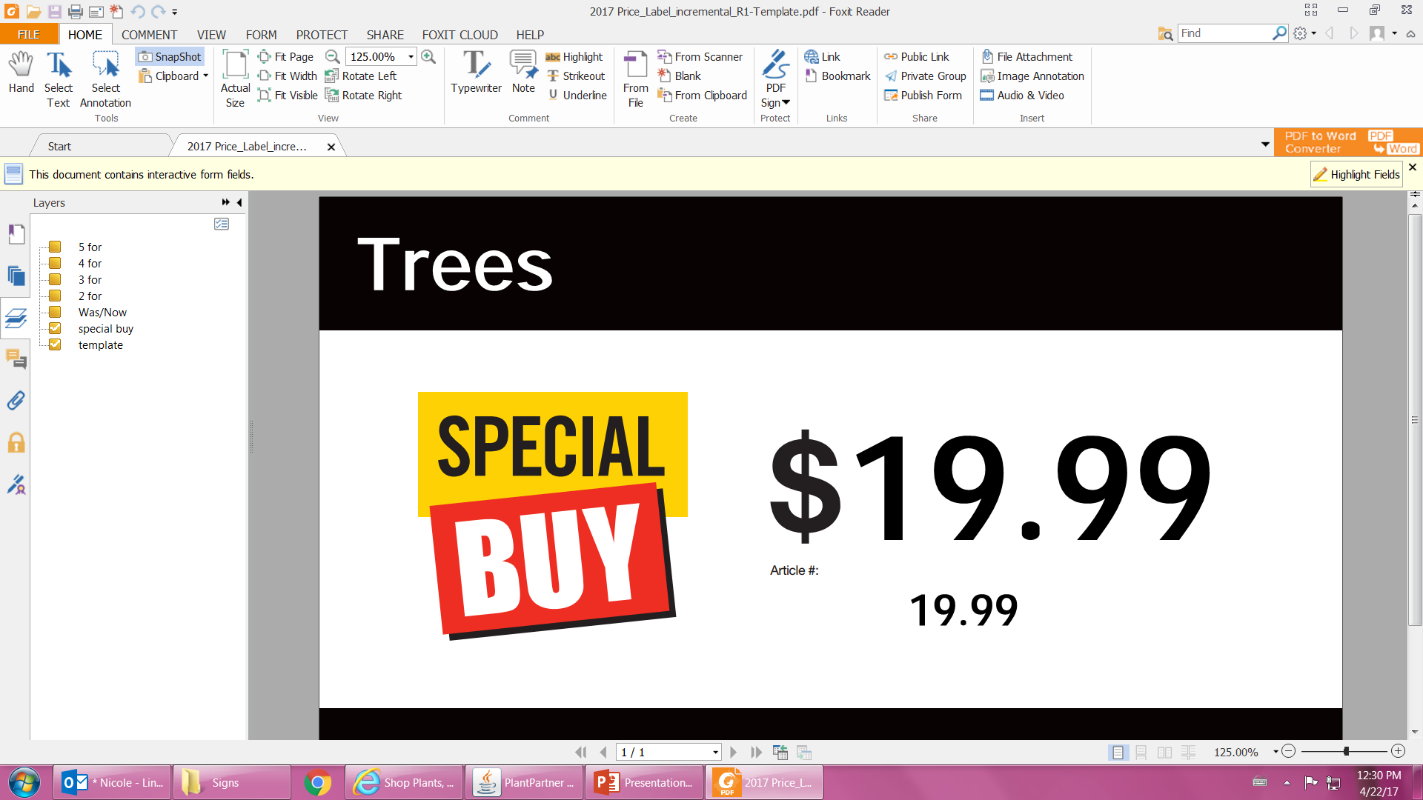
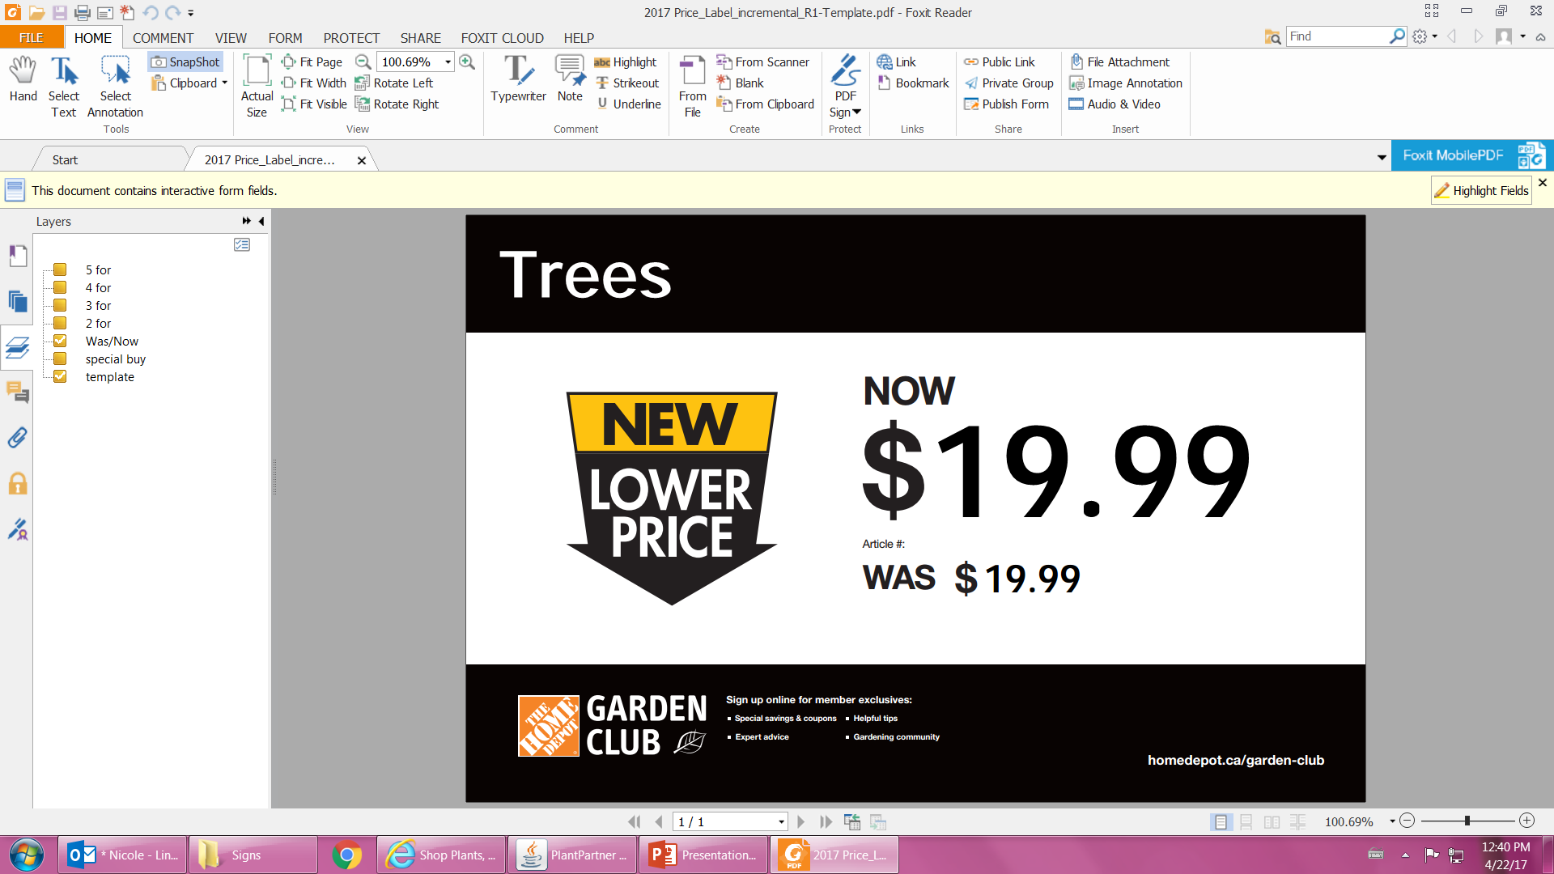
10” Hanging Basket
2 for $19.98
GARDEN CLUB
Sign up online for member exclusives:
Special savings & coupons
Expert advice
Helpful tips
Gardening community
homedepot.ca/garden-club

Slide 2
10” Hanging Basket
2 for $19.98
GARDEN CLUB
Sign up online for member exclusives:
Special savings & coupons
Expert advice
Helpful tips
Gardening community
homedepot.ca/garden-club

