Slide 1
Jeffery’s Greenhouses
Merchandiser Supervisors
Safety Session
March 10, 2022

Slide 2
Safety Session Agenda
Internal Responsibility System (IRS)
Accident Year to Date Report
2022 Health and Safety Goals and Objectives
Safety Topic Focus:
Fall Prevention
Overexertion Injury Prevention
Situational Awareness
Documentation in H/S
Accident Reporting Procedures
Covid-19 Update
    Living with and Managing Covid-19.

Slide 3

Internal Responsibility System (IRS)
Everyone is responsible for their own health and safety as well as the health and safety of their fellow workers.
Everyone must ensure that safe practices, procedures and conditions are maintained (as per legislation and policy).
The ones responsible for the work are responsible for the health and safety.
Everyone has a role to play. It is essential that YOU know YOUR role.

Slide 4

Workers in Ontario have Three Rights
Right to Know Hazards
Right to Refuse Unsafe Work
Right to Participate in
H&S system

Slide 5

Worker’s Safety Concern
A worker shall,
Report to his or her employer or supervisor the absence of or defect in any equipment or protective device of which the worker is aware and which may endanger himself, herself and
Report to his or her employer or supervisor any contravention of this Act or the regulations or the existence of any hazard of which he or she knows.
OHSA Sec 28 (1) (c) (d)

Slide 6

Worker’s Safety Concern
An Employer/Supervisor Shall:
“Take every precaution reasonable in the circumstances for the protection of the worker”.
OHSA Section 25 (2) (h) & 27 (2) (c)

Slide 7
What does this all mean?
Know your Rights as an Employee in Ontario.
Know your Staff’s Rights as an Employee in Ontario.
Know your Roles & Responsibilities within the Internal Responsibility System (IRS) **Identify Hazards Immediately**
Bring any safety or reprisal concerns to any of the following:
Your Supervisor or Team Leader
Your Manager (Brian or Barb)
Joint Health and Safety Member (see listings on website)
Health and Safety Coordinators (Allison or Gina)
Owners (Barb or Rodd)

Slide 8
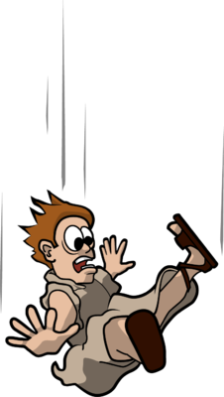
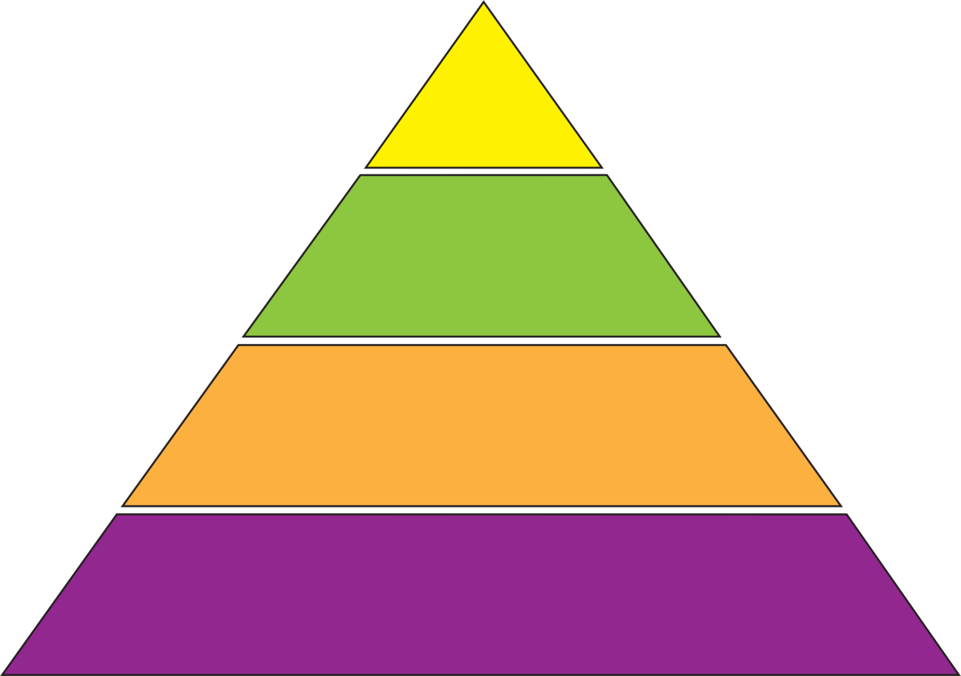

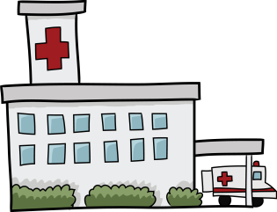
Jeffery’s Greenhouses Plant II
2021 Accidents Summary
0
Incidents
4
First Aid Only
Medical Claim &
No Loss Time
3
Medical Claim
& Loss Time
2
Covid 19 and/or Possible Exposure
3

Slide 9
Injury Stats

Slide 10


Health and Safety 2021 Objectives
Jeffery’s Greenhouses Plant II
1) We wish to reduce our Lost Time Injury (LTI's) to a Frequency Rate of zero.
2) To reduce our Non-Lost Time Injury (Medical only) Frequency Rate to one.

Slide 11
2022 Health and Safety Goals for Plant II
1) We wish to reduce our Lost Time Injury (LTI's) to a Frequency Rate of zero.
2) To reduce our Non-Lost Time Injury (Medical only) Frequency Rate to one.
Completing outstanding CIP items
Participate in the new WSIB Safety Excellence Program.
Edit Rack Safety Video
Implement the use of Safety Talks for Fall and Overexertion Injury Prevention–ongoing training not just during orientation!

Slide 12

WSIB 2020 Highlights
Schedule 1 Employers
Worker age is a predictor of the most likely injury they will experience. Young workers tend to be struck by objects and equipment while older workers tend to be injured because of falls on the same level.

Slide 13
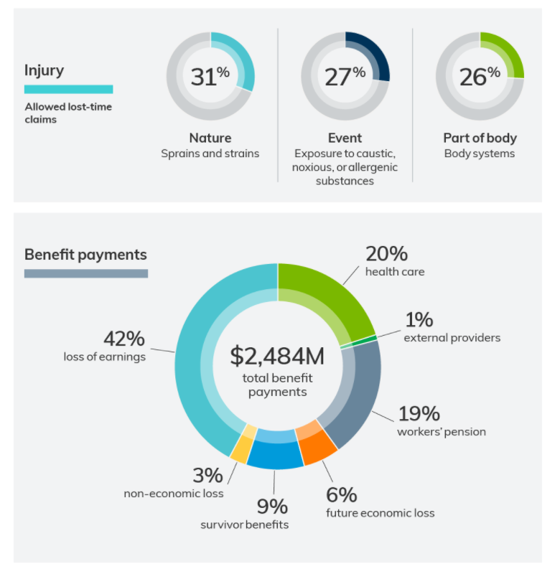
WSIB 2020 Highlights
Schedule 1 Employers
Worker age is a predictor of the most likely injury they will experience. Young workers tend to be struck by objects and equipment while older workers tend to be injured because of falls on the same level.

Slide 14
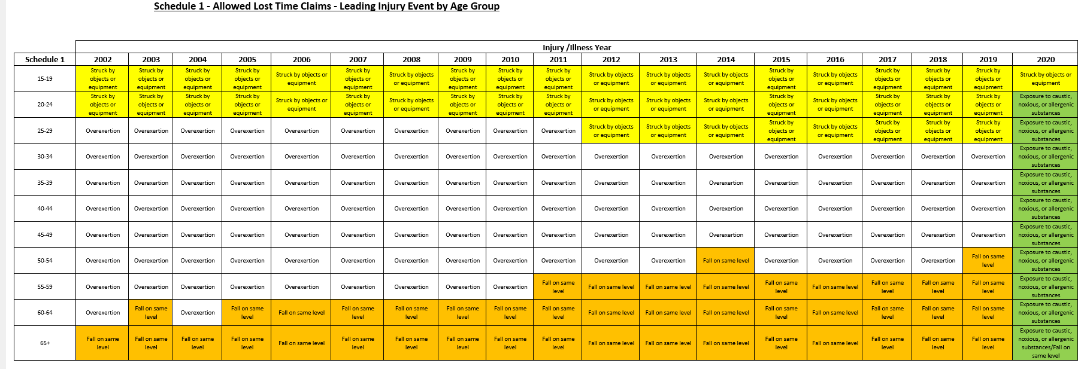

Slide 15
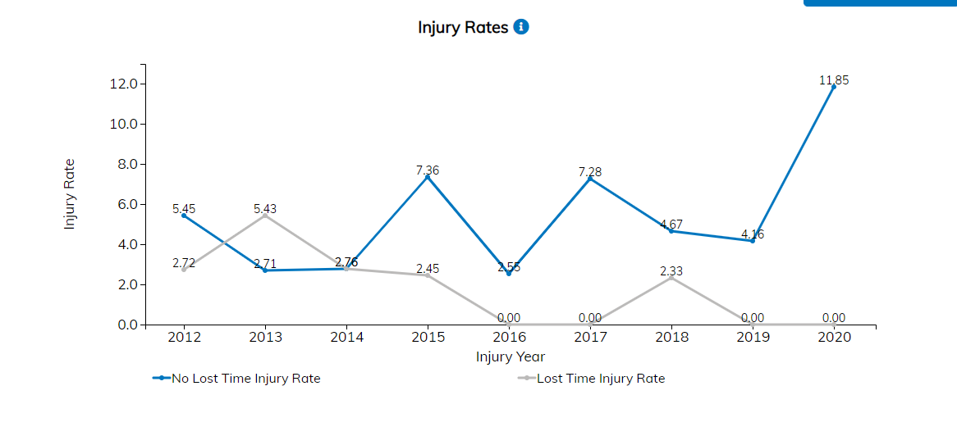
Safety Check WSIB Plant II Injury Rates

Slide 16
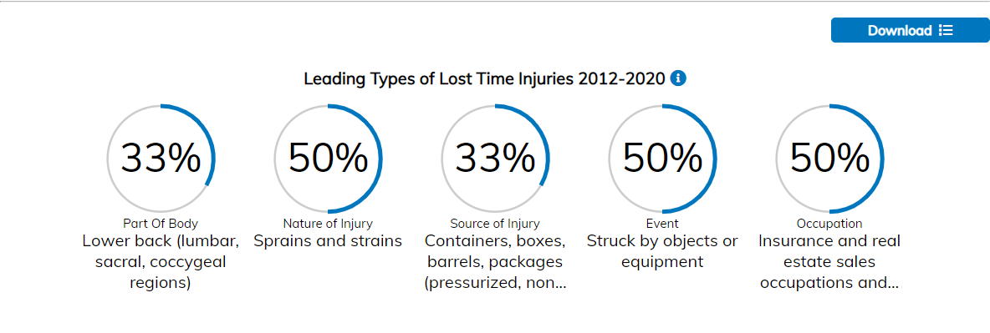
Safety Check WSIB Plant II Leading Types of Injury

Slide 17
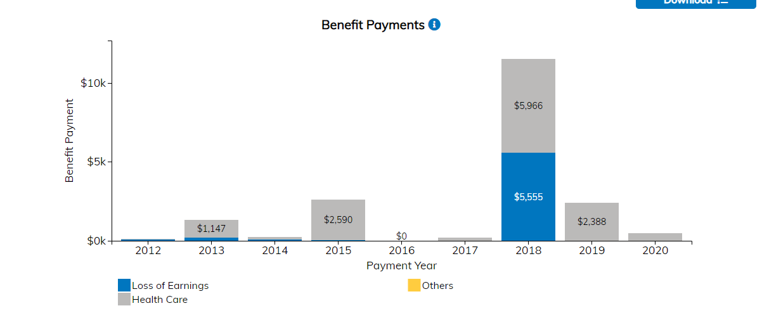
Safety Check WSIB Plant II Benefit Payments

Slide 18



What are everyone’s safety responsibilities?

Slide 19
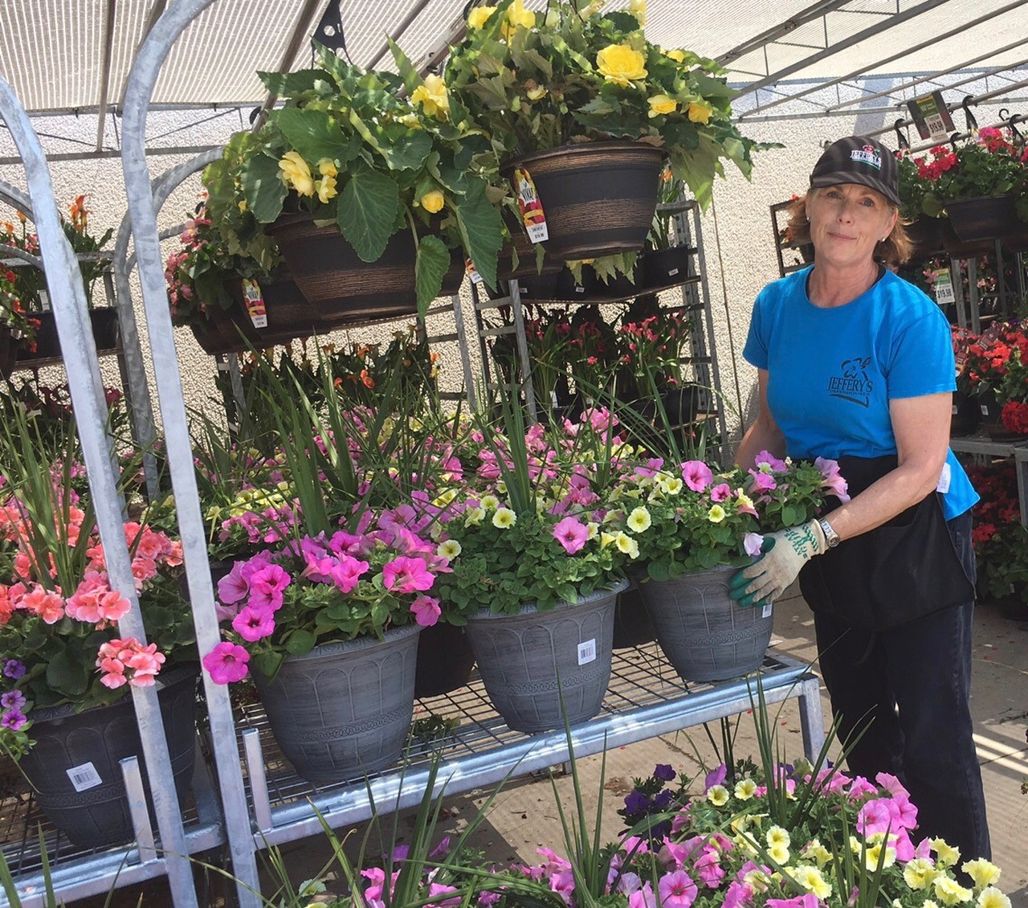
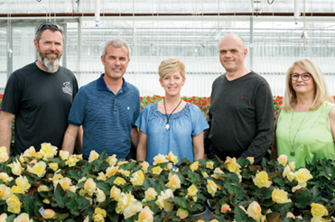
Responsibility
Everyone in the workplace is responsible for health and safety
Employer + Supervisors
YOU the Employee
Notes:
Responsibility.
Who is responsible for safety on the farm? Everyone on the farm is responsible for health and safety including the farmer/employer, farm supervisor, team leader, family members and all farm workers.

Slide 20

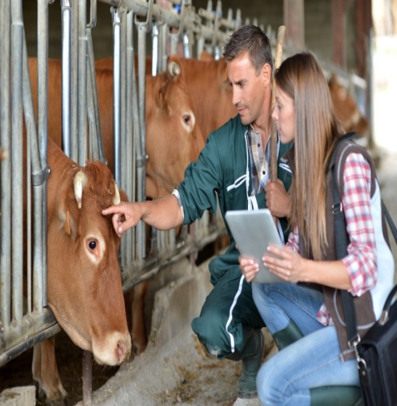

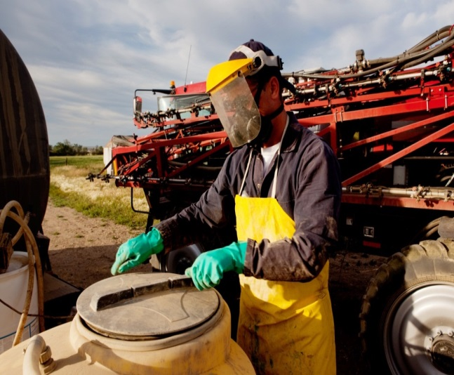
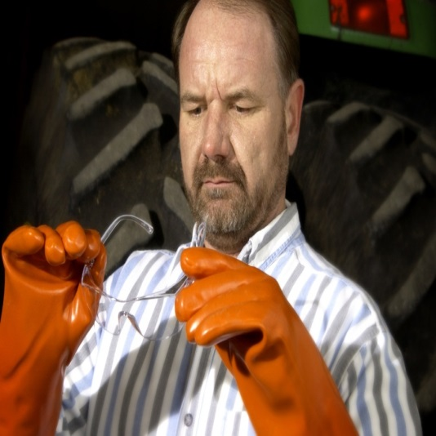

Employer’s Responsibilities
Safe Workplace
Training
Identify Hazards
Hazard Control
Provide PPE
First Aid
Notes:
Jeffery’s Greenhouses is responsible for:
Providing a safe place to work
Providing safe work methods and promoting safe work practices among all workers
Making sure employees have the training and supervision needed to do their job safely
Telling employees about the hazards of their job
Training employees to recognize other hazards
Putting hazard control measures in place
Providing PPE and showing the workers how to properly use the PPE
Providing first aid supplies, facilities and qualified first aiders

Slide 21

Group Participation Time.
What are your responsibilities as a supervisor when it comes to safety?

Slide 22
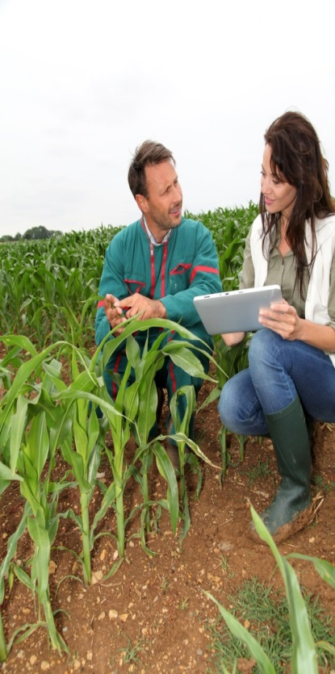
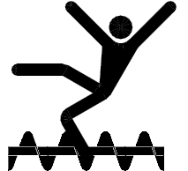
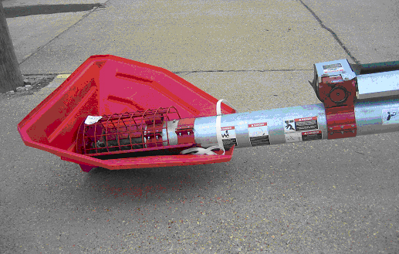
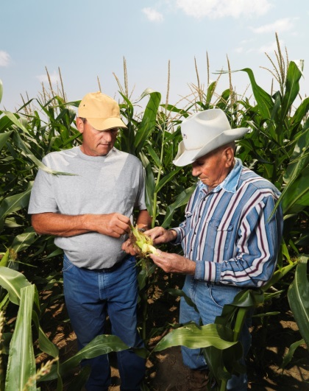
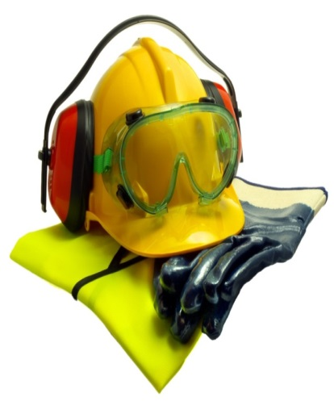
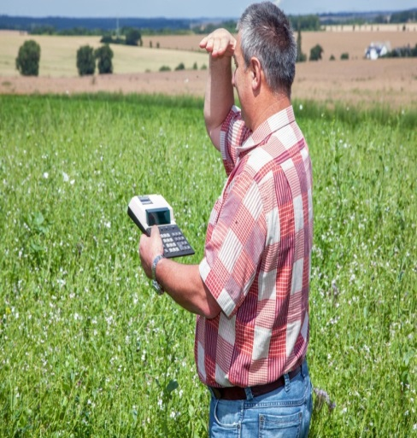
Supervisors and Team Leaders
Control Hazards
Guidance
Identify Hazards
Ensure PPE Use
Train Workers
Inspections
Notes:
Supervisors are responsible to:
Ensure proper guidance in working safely
Inform workers about the hazards
Identify, eliminate or control hazards
Train workers to do their job safely and to deal with hazards, correcting any substandard acts
Ensure PPE is available (where required), properly used and maintained
Inspect work sites and ensure they are safe to work in
Ensure incidents are properly reported and followed up with corrective actions.
Ensure proper emergency procedures are followed

Slide 23
Supervisor and Competency….
An Employer Shall, when appointing a supervisor, appoint a competent person.
Competent person means;
Competent by knowledge, training or experience to organize the work.
Familiar with the OHSA and regulations that apply to work.
Knowledge of potential or actual health and safety dangers in the workplace.

Slide 24
Supervisors and Key Health and Safety Duties
Supervisors under the Occupational Health and Safety Act include requirements that a supervisor shall;
Advise a worker of any potential or actual health and safety dangers known by the supervisor.
Ensure a worker work in a manner and with the protective devices, measures and procedures required by the legislation
Ensure a worker uses or wears personal protective equipment (PPE) required by the employer
Take every precaution reasonable in the circumstances for the protection of the worker.

Slide 25
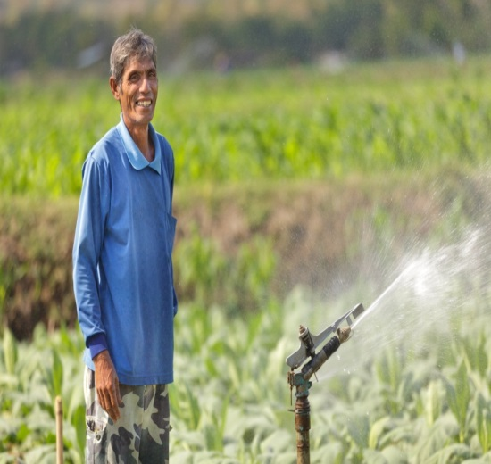
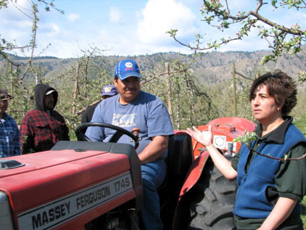
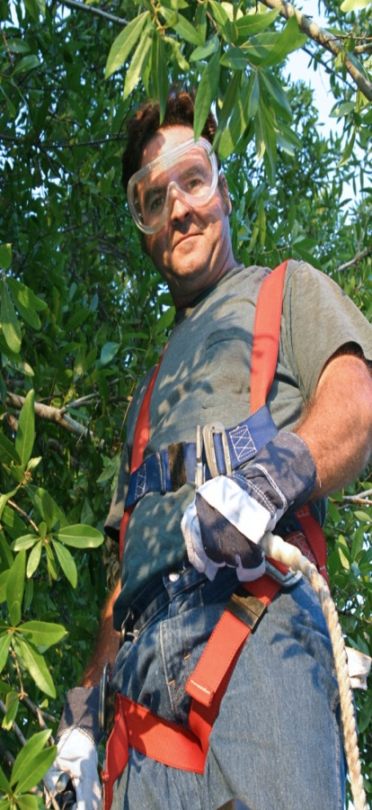

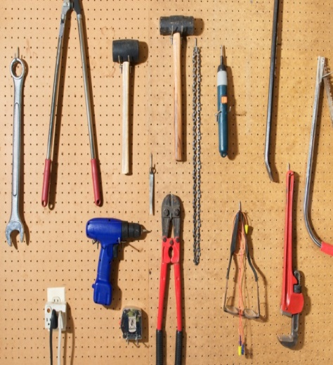
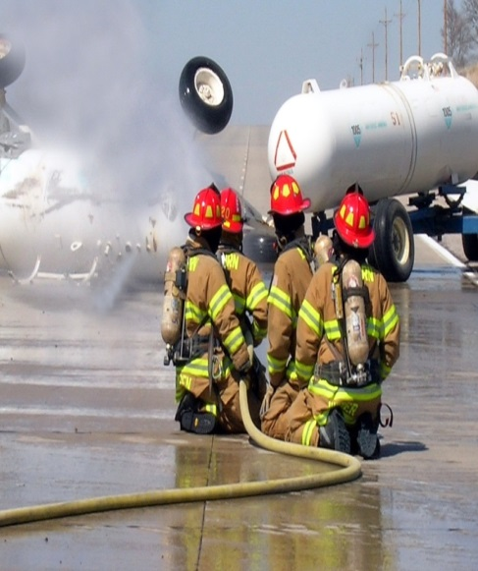
Worker’s Responsibilities
Take Training
Work Safely
Use Safety Devices
Report Hazards
Housekeeping
Emergencies
Notes:
Workers are responsible for
Working and acting safely
Participating in safety training
Using safety equipment, machine guards, safety devices, and personal protective equipment
Reporting unsafe conditions, injuries and illnesses immediately
Looking for hazards daily and correcting hazards as they are observed when possible and if safe to do so
Keeping tools, materials, equipment, and buildings clean and in good order
Knowing location of emergency equipment and procedures, first aid supplies and how to contact supervisors in an emergency

Slide 26
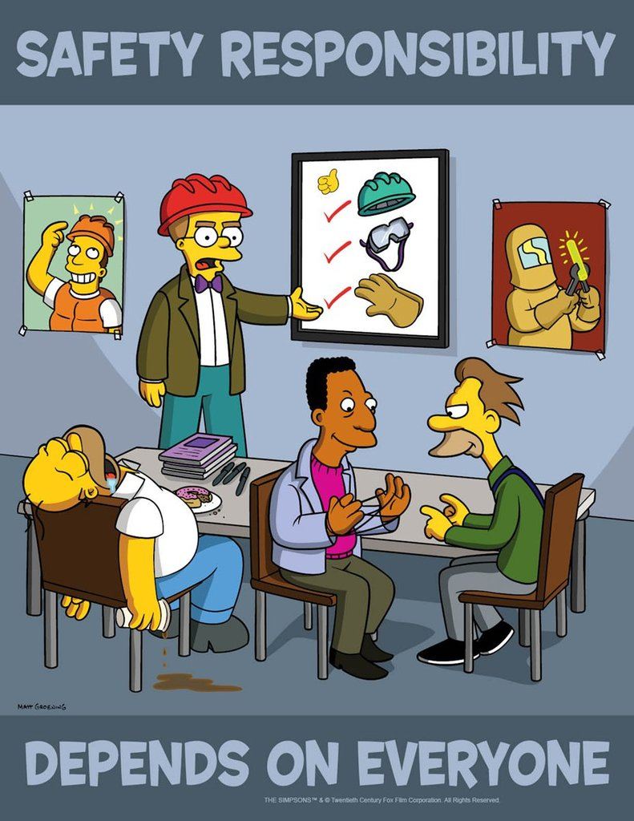


Safety is Everyone’s Responsibility

Slide 27

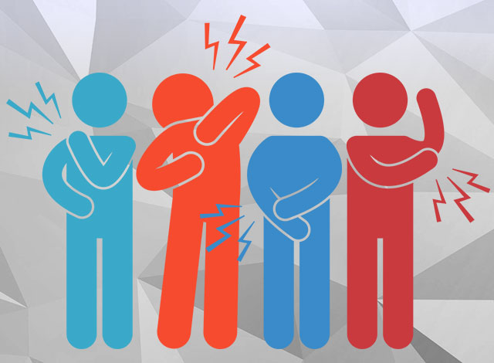

Safety Focus Topics
Fall
Protection
Overexertion
Injuries
Situational Awareness

Slide 28
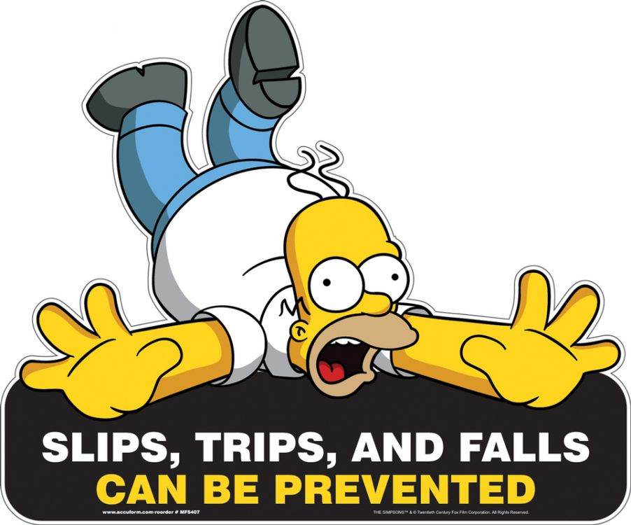
Safety Topic: Fall Prevention

Slide 29

Discussion Time: Fall Prevention
Safety Moment
Story Share

Slide 30
Safety Topic Focus-Fall Prevention
Each year there are about 17,000 lost-time injuries due to falls in the workplace*
65% of all fall-related injuries are from "same level"*
One in five lost-time injuries result from falls*
Every year about 20 people die in Ontario because of workplace falls*
80 workers are injured every day because of a fall - that's one every 20 minutes*
An average WSIB claim is $11,771; factor in other costs like lost productivity and staff replacement, and the cost can be as much as four times more - approximately $59,000 per injury*
Source: *WSIB "Preventing Slips, Trips and Falls in the Workplace"

Slide 31

Safety Topic Focus-Fall Prevention
How do I protect myself and others?
Both slips and trips result from some kind of unintended or unexpected change in the contact between the feet and the ground or walking surface.
This fact shows that good housekeeping, quality of walking surfaces (flooring), selection of proper footwear, and appropriate pace of walking are critical for preventing fall incidents.

Slide 32
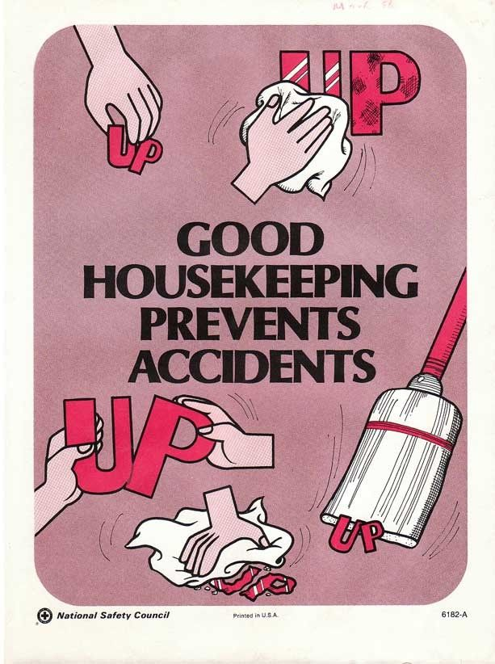
Safety Topic Focus-Fall Prevention
How do I protect myself and others?
Housekeeping
Good housekeeping is the first and the most important (fundamental) level of preventing falls due to slips and trips. It includes:
cleaning all spills immediately
marking spills and wet areas
mopping or sweeping debris from floors
removing obstacles from walkways and always keeping walkways free of clutter
securing (tacking, taping, etc.) mats, rugs and carpets that do not lay flat
always closing file cabinet or storage drawers
covering cables that cross walkways
keeping working areas and walkways well lit
replacing used light bulbs and faulty switches
Without good housekeeping practices, any other preventive measures such as installation of sophisticated flooring, specialty footwear or training on techniques of walking and safe falling will never be fully effective.

Slide 33
Safety Topic Focus-Fall Prevention
How do I protect myself and others?
Footwear
In workplaces where floors may be oily or wet or where workers spend considerable time outdoors, prevention of fall incidents should focus on selecting proper footwear.
Since there is no footwear with anti-slip properties for every condition, consultation with manufacturers’ specifications is highly recommended.
Properly fitting footwear increases comfort and prevents fatigue which, in turn, improves safety for the employee.

Slide 34
Safety Topic: Fall Prevention
As a team, lets discuss….
how can we reduce the risk of merchandisers falling this season?

Slide 35
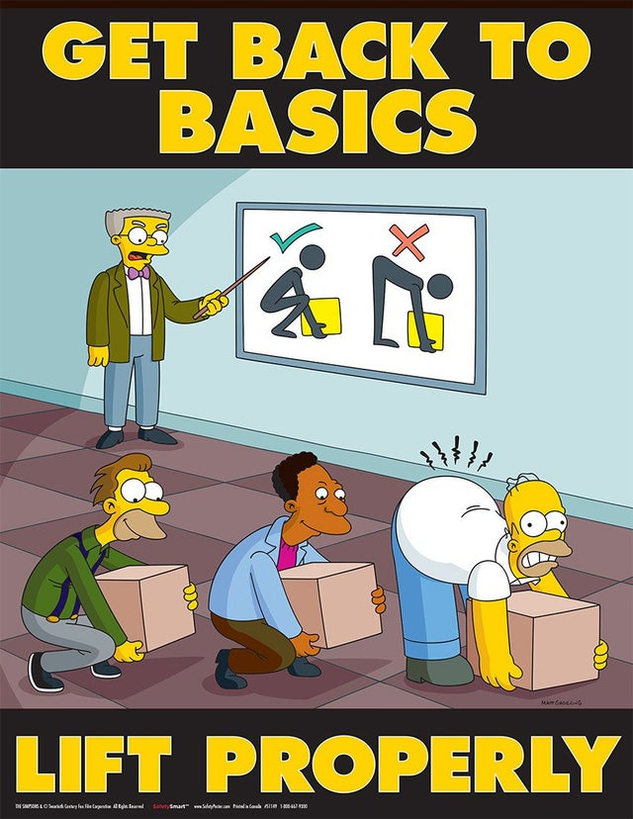
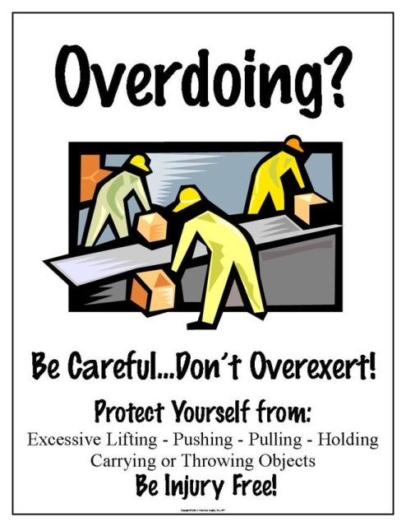
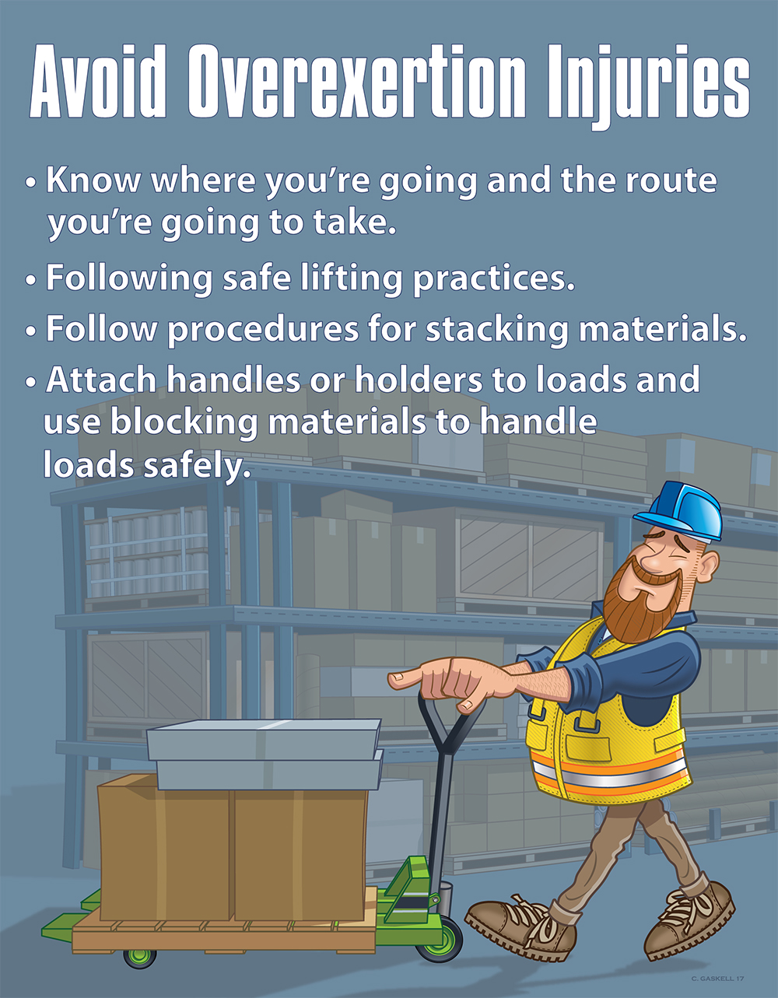
Safety Topic: Overexertion or Musculoskeletal Injuries (MSI)

Slide 36
Discussion Time: Overexertion
Safety Moment
Story Share

Slide 37
Safety Topic: Overexertion
What Is an Overexertion Injury?
Overexertion injuries are a common occurrence in the modern workplace. When a worker sustains an overexertion injury, he or she may require ongoing medical treatment. Even without medical treatment, the worker may need to rest until he or she recovers

Slide 38
Safety Topic: Overexertion
Some of the tasks we perform at work such as lifting, reaching, and repeating the same movements can strain our bodies. In some situations, these tasks can result in an injury to the muscles, tendons, ligaments, nerves, blood vessels, and joints of the neck, shoulders, arms, wrists, legs, and back. This type of injury is called a musculoskeletal injury.

Slide 39
Overexertion Injuries
Injuries related to overexertion activities include:
Pulled back muscle
Pulled neck muscle
Muscle strain
Joint sprain
To keep workers safe and happy, proper techniques to prevent overexertion injuries are a must in the workplace. Whether the setting is manufacturing or agriculture, best practices need to be in place to provide workers the resources to remain safe and healthy in the workplace.

Slide 40
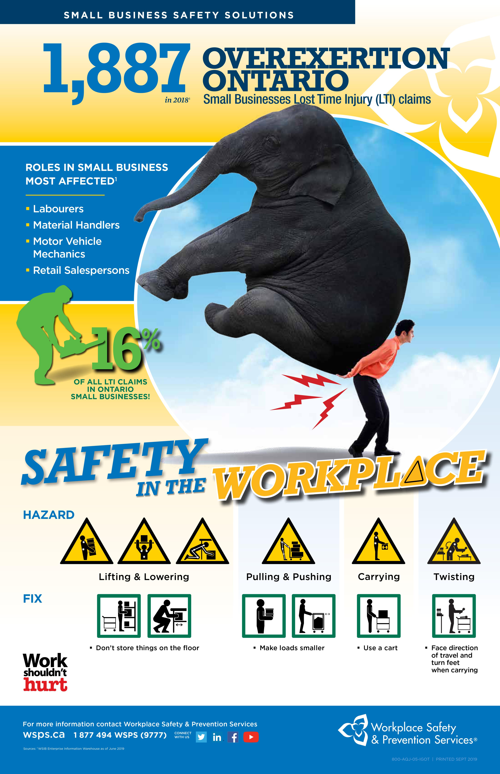
Overexertion and musculoskeletal injuries are the one of the leading causes of injury and historically been a main factor of injuries for merchandisers at Jeffery’s. Whether you are returning to work after not being as active as usual or someone who is working long hours with spring busyness, you can strain yourself from pushing your body too hard.

Slide 41
This can happen by lifting, pushing, or pulling something too heavy for you. Overexertion can lead to a “musculoskeletal disorder,” with symptoms including swelling, numbness, stiffness, chronic pain, or the permanent loss of mobility in muscles, tendons, ligaments, and joints. These injuries can lead to debilitating pain, physical therapy, and missed time at work all resulting in increased claim costs.

Slide 42
Safety Topic: Overexertion Goals
Goal: implement an effective strategy to help prevent musculoskeletal injuries in the workplace.
identify factors that place workers at risk;
understand the steps in preventing injuries;
understand how control measures can reduce the risk of injuries; and
investigate injuries and signs or symptoms

Slide 43
Safety Topic: Overexertion Factors
The primary risk factors we look for when assessing the risk for overexertion injuries are:
• Forceful exertions;
• Awkward postures;
• Rapid movements;
• Unanticipated muscle loading.

Slide 44
Safety Topic: Overexertion Factors
Forceful exertions
Manual material handling tasks such as pushing, pulling and lifting typically require forceful exertion. Such exertion may result in back pain or other musculoskeletal disorders. However, other tasks such as using hand
tools and operating equipment can also require forceful exertions on a particular muscle or group of muscles.
Discuss: What tasks require the greatest amount of forceful exertion? What are possible improvements to reduce the amount of force exertion used?

Slide 45
Safety Topic: Overexertion Factors
Awkward postures
Awkward postures are any non-neutral body postures that are either repeated or sustained. Bending and twisting any of the body parts in an unnatural manner increase potential for overexertion injuries, especially when combined with forceful exertions.
What types of awkward postures are required in the tasks performed?
Brainstorm and discuss possible improvements to reduce awkward postures.

Slide 46
Safety Topic: Overexertion Factors
Rapid movements and unanticipated muscle loading
These increase the potential for overexertion because they do not allow the body to apply muscle strength in an efficient manner. Slipping, rushing or reacting to the sudden movement of a load, activates muscles quickly. Such action can result in strains and sprains because it is difficult to use the various supporting muscle groups in a coordinated, effective manner.
What types of tasks or conditions in your workplace require rapid exertions or applications of force?
Brainstorm and discuss possible improvements to reduce rapid exertions.

Slide 47
Safety Topic: Overexertion Factors
Ways to reduce rushing and sudden, unexpected muscle loading include:
• Avoid forced pacing – provide adequate time and buffer space;
• Minimize the potential for loads to shift during handling;
• Avoid the need for “catching” loads or using the body to stop the movement of loads;
• Minimize tripping and slipping hazards;
• Provide well-designed handles on loads and carts;
• Avoid having to open doors or climb steps when pushing/pulling or carrying loads;
• Reinforce the importance of warming up and loosening up before performing physical exertions.

Slide 48

Safety Topic: Overexertion Prevention
You might be surprised to learn that staying hydrated can lower your risk of sustaining overexertion injuries. Research shows that up to two in three adults are chronically dehydration. If you are dehydrated, your muscles will lose some of their natural elasticity. As a result, they'll be more susceptible to overexertion injuries. To prevent this from happening, you need to stay hydrated by drinking plenty of water throughout the workday.

Slide 49

Safety Topic: Overexertion Prevention
Taking breaks can also minimize your risk of sustaining overexertion injuries. After all, overexertion injuries involve physically exerting your body beyond its capabilities. If you take breaks, your body have a chance to recuperate, thereby lowering the risk of an overexertion injury.
Insist your staff take breaks.
Limit shift to no more then 8 to 10 hours.

Slide 50
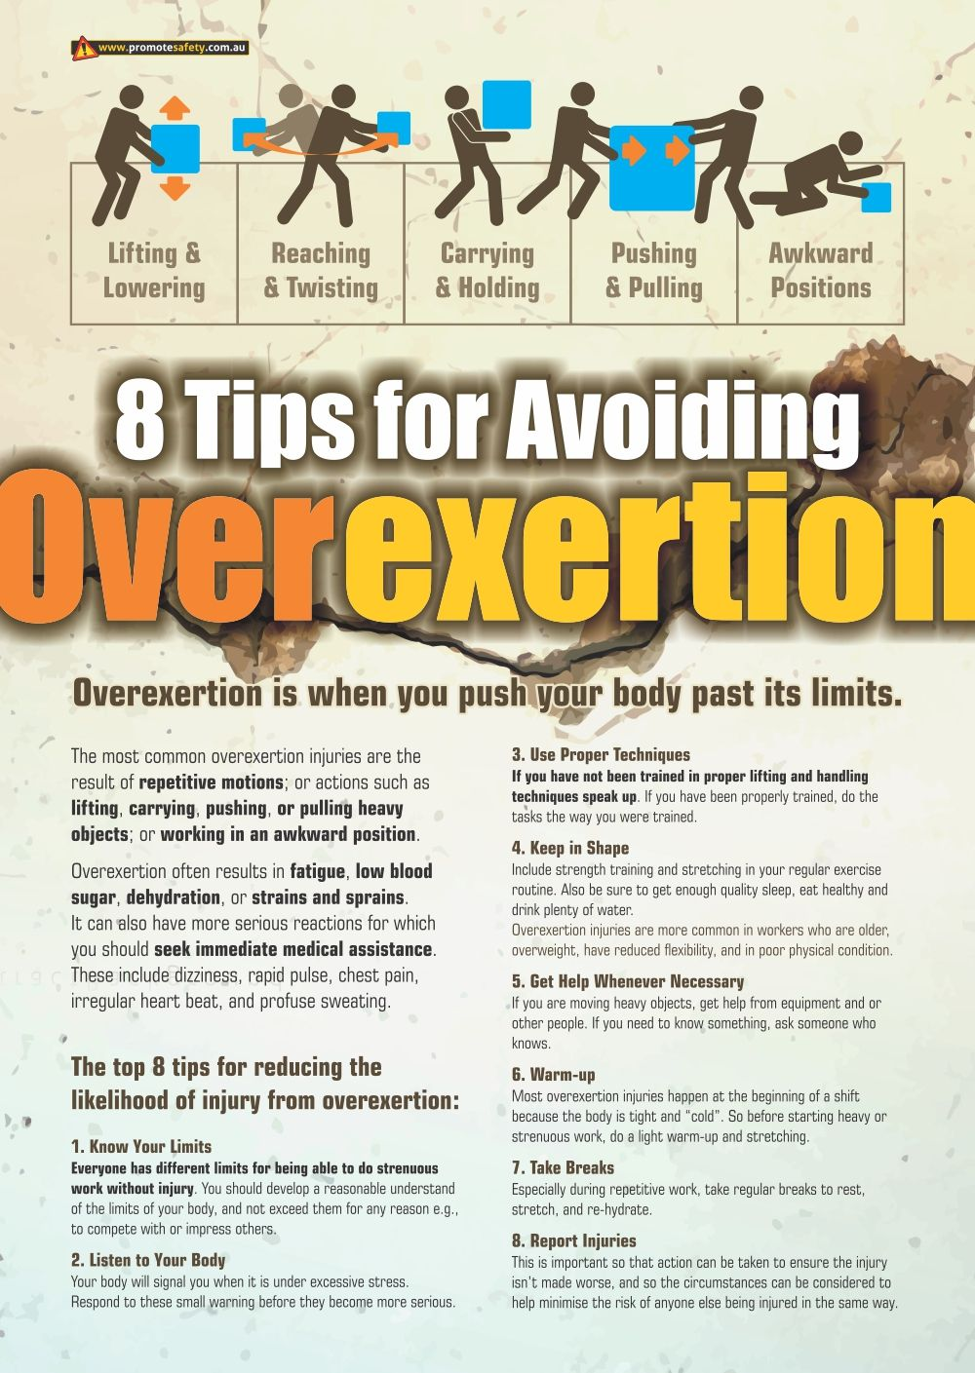
Safety Topic: Overexertion Prevention
Know your limits
Listen to your body
Use proper techniques
Keep in shape
Get Help When Necessary
Warm-Up
Take Breaks
Report Injuries

Slide 51
Safety Topic: Overexertion investigate injuries and signs or symptoms
Workers may notice pain, numbness, tingling, weakness while on the job.
Sometimes pain is just part of the normal human condition and can be ignored.
Other times it’s a manifestation of an injury or disease. To lessen the likelihood of an injury or disease, it may be necessary to reduce exposure to physical movements at work that have the potential to place workers at risk of injury (strain) or disease (like tendinitis or carpal tunnel syndrome).
Its important to note that each individual’s response to physical exposure is different.
The human body is designed to be active so eliminating all physical activity is also unhealthy.

Slide 52
Safety Topic: Overexertion investigate injuries and signs or symptoms
It is important to recognize the signs and symptoms that could indicate an MSI or Overexertion injury;
Signs (which can be observed) could include swelling, redness and/or difficulty moving a particular body part.
Symptoms (which can be felt but not observed) could include numbness, tingling, and/or pain.
Signs and symptoms of MSI may appear suddenly– for example from a single incident, OR they may appear gradually over a longer period.

Slide 53
Safety Topic: Overexertion investigate injuries and signs or symptoms
Make sure to include the signs, symptoms and prevention of overexertion MSI injuries as part of your training. Not only during orientation but also throughout the season.
Tell your staff if they are experiencing signs or symptoms to alert you immediately.
An MSI may be treated more effectively if it is discovered and reported early. Don’t assume they will do this naturally.

Slide 54
Safety Topic: Overexertion
As a team, lets discuss….
how can we reduce the risk of merchandisers overexertion injuries this season?

Slide 55


Slide 56
Discussion Time: Situational Awareness
Safety Moment
Story Share

Slide 57
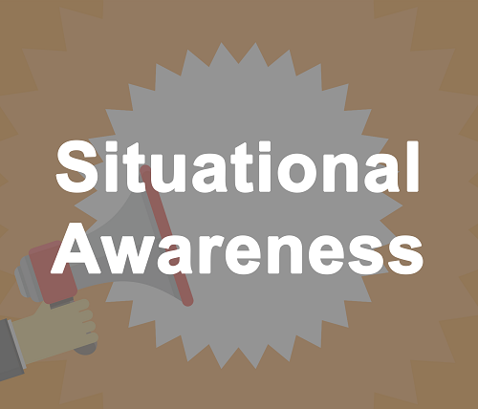
Safety Topic: Situational Awareness
Situational awareness is being aware of what is happening around you in terms of where you are, where you are supposed to be, and whether anyone or anything around you is a threat to your health and safety. Our knowledge, experience and education enables us to understand what is going on around us and helps us to determine if it is safe. This means that everyone's situational awareness is individual and potentially different. We use our situational awareness to make decisions at home and at work.

Slide 58
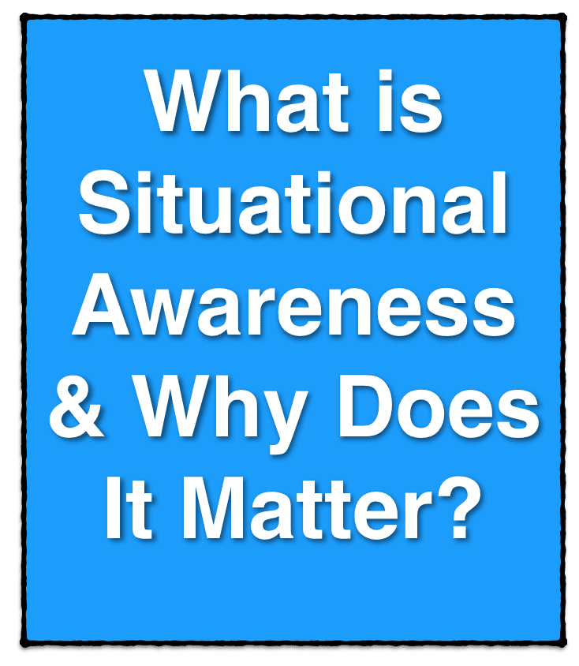
Safety Topic: Situational Awareness
Our situational awareness is only as accurate as our own perception or reading of the situation, so what we think is happening may not accurately reflect reality. How we read a situation can be influenced by many things such as the type of information we have been given, our own experience and distractions in the workplace.

Slide 59
Safety Topic: Situational Awareness— Signs you are losing it. “If it feels wrong then it probably is”
Situation awareness is the understanding of what is happening now, and given that information, what may happen in the future. Given this, there are some clues that situation awareness is becoming degraded:
Fixation on one thing to the exclusion of everything else
Poor communications, such as vague or incomplete statements
Not following established procedures
Future states that were expected do not materialize
Not having the ‘time to think’.

Slide 60
Safety Topic: Situational Awareness—
Situation awareness may be lost because of fatigue, distractions, stressful situations, high workload, vigilance failures, poorly presented information, forgetting key information and poor mental models. Optimising these (and other influences on human performance) is central to the human factors approach.
The result of losing situation awareness (or having an inadequate awareness) may be poor decision making, risk-taking and other unsafe behaviours.

Slide 61
Safety Topic: Situational Awareness
Why should you improve it?
It is important that you know how many problems you face and how serious they are. The temporary loss or lack of situational awareness is a casual factor in many accidents. Often there is so much 'going on' in your work environment, or you become so absorbed in your own thoughts, that you fail to spot those things that could pose a serious threat to your health and safety. Our situational awareness can be further reduced in times of high workload or when under pressure to get a job done on time. In these situations, it is essential to maintain a high level of situational awareness to stop accidents and near misses.

Slide 62
Safety Topic: Situational Awareness
Where and when should situational awareness techniques be used?
Assessment of your working environment should occur continually, but especially in the following situations:
When beginning work on a new project/contract/customer location.
When you think the work environment has changed since your last time there.
When working with new or different workmates.
Before complacency has set in-it can be a silent killer!

Slide 63
Safety Topic: Situational Awareness
Practice the SLAM method. SLAM consists of four simple steps
STOP - Engage your mind before your hands. Look at the task in front of you. Ask the following questions: Is this a new task? Has it changed? When was the last time I completed this task? Am I comfortable with it? Do I need training?
LOOK -Observe the work area before, during and after completing a task to inspect for hazards.
ASSESS -Identify potential threats and if the task can be done safely with the equipment available.
Manage -Ensure workers encounter minimal hazards, then follow up regularly to find out what is going well and what could be improved.

Slide 64
Safety Topic: Situational Awareness
Speak up when dangerous situations occur. Report accidents, injuries, near-misses or suspicious activity that could put the team in danger. Remind all workers they have the authority and responsibility to stop work when they notice a potential safety risk.
Recognize team member tendencies. Watch for changes in the performance of those nearby and step in to help if necessary. This can help you prevent accidents before they happen.
Prevent fatigue. Most adults need between seven and nine hours of sleep each night. If fatigue becomes a factor, consider adjusting routines to get a more consistent sleep schedule.

Slide 65
Safety Topic: Situational Awareness
Understand the pace of your environment. Pace fluctuates depending on the task, crew and outside elements. Watch for unplanned variables and adjust accordingly for safety.
Beware electronic distractions. Avoid using an electronic device while walking or performing other tasks. Even listening to music can be a distraction and a safety hazard.
Have an exit plan. If a work threat is imminent, have a designated safe place to move to. Make sure everyone knows the plan and reviews it regularly.

Slide 66
Safety Topic: Situational Awareness
Training and Reinforcement
Situational awareness “creates a separate dimension of hazard control” because it requires specialized education, training and conditioning – or reinforcing exercises such as real-time simulations.
The goal is to get workers accustomed to identifying hazards, understanding what actions to take, and knowing where to find needed equipment and how to use it

Slide 67
Safety Topic: Situational Awareness
Training and Reinforcement
Another key concept for employee training is the “what if” strategy: identifying common situations that could prove hazardous and then considering ways to prevent or properly react to them.
If we don’t train people to have situational awareness, then all the compliance and all the programs really don’t matter because they don’t get used in real time.

Slide 68
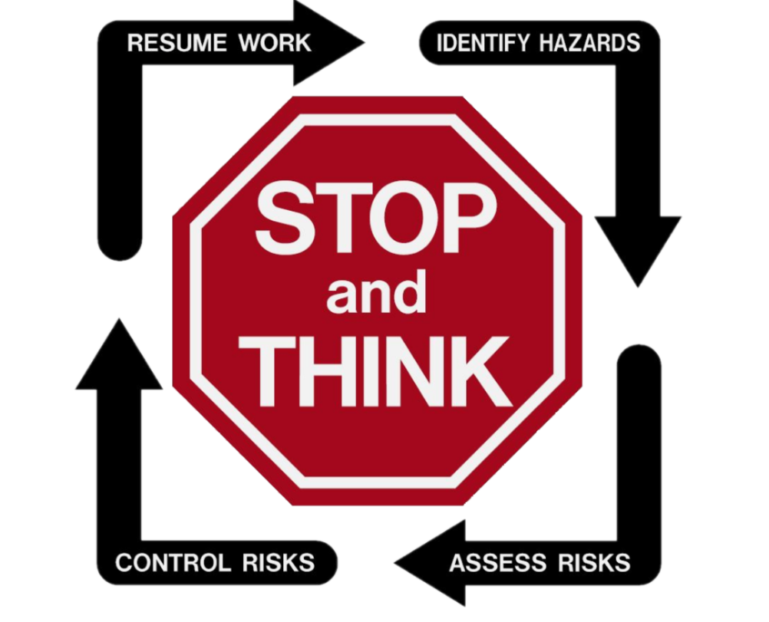
Safety Topic: Situational Awareness
Training and Reinforcement
Training for situational awareness is part of a multi level training program. After following all applicable regulations and orientation, its the ongoing third step in the process:

Slide 69
Safety Topic: Situational Awareness
“The best way to start is to predict at the very beginning of the day and ask yourself, ‘When am I most likely going to make a mistake, where will it be and what time will it be?’
Predictions then allow workers to recognize the moment(s) when they need to raise their awareness. It’ll help you get out of those zombielike moments.
Another quick technique workers can use to pull themselves out of “autopilot” called “S.T.O.P.”:

Slide 70
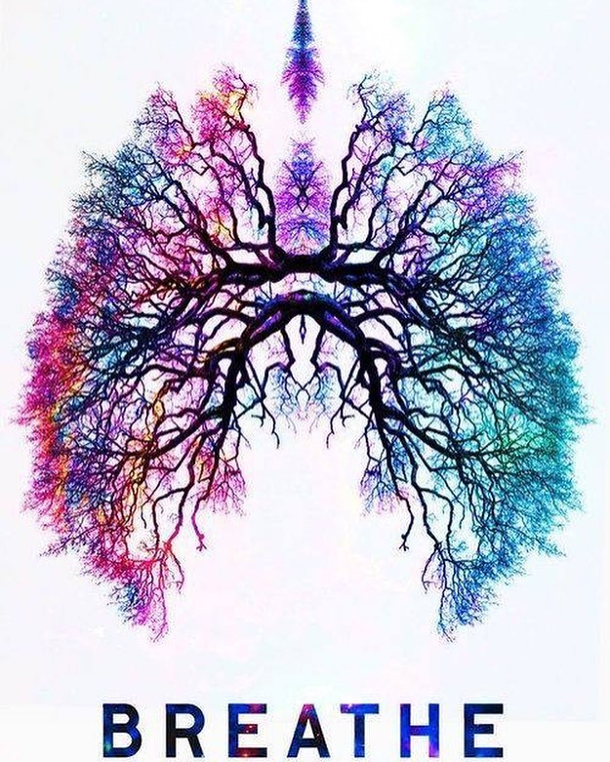
Safety Topic: Situational Awareness
Stop
Take a breath
Observe your surroundings
Proceed with awareness
Taking a deep breath, believe it or not, it actually pulls your brain out of autopilot physiologically. There’s something to utilizing that deep breath and utilizing your senses. It’s a different part of your brain that gets engaged and pulls you out of autopilot.

Slide 71
Safety Topic: Situational Awareness
Situational awareness is important to everyone - it is important that everyone is aware of their surroundings and the potential hazards they face. It is important that everyone is looking out for his or her own safety as well as looking out for their workmates. Remember that we all want to go home safely the way we came to work safely.

Slide 72
Safety Topic: Situational Awareness
As a team, lets discuss….
how can we improve the situational awareness of merchandisers this season?

Slide 73

Health and Safety Documentation

Slide 74
Documentation in Health and Safety
Due Diligence
Applied to occupational health and safety, due diligence means that employers shall take all reasonable precautions, under the particular circumstances, to prevent injuries or incidents in the workplace.
This duty also applies to situations that are not addressed elsewhere in the occupational health and safety legislation.
Reasonable precautions are also referred to as reasonable care. It refers to the care, caution, or action a reasonable person is expected to take under similar circumstances.

Slide 75
Documentation in Health and Safety
Due Diligence-What
"Due diligence" is important as a legal defense for a person charged under occupational health and safety legislation. If charged, a defendant may be found not guilty if he or she can prove that due diligence was exercised.

Slide 76
Documentation in Health and Safety
Why?
In the event of a lawsuit, complete and thorough documentation protects an employer's interests as well as the supervisors.
The documentation can support management's actions in terminating an unsuccessful employee.
It also can prove that the employee was terminated for reasons that are legal as opposed to others such as illegal discrimination.

Slide 77
Documentation in Health and Safety
Why?
Properly documenting issues and retaining records.
Make records at the time of, or shortly following, an incident. Don’t wait weeks or months to create your documentation.
Focus on the facts, not generalizations or subjective comments.

Slide 78

Documentation in Health and Safety
How?
Therefore, think before you write

Slide 79
Documentation in Health and Safety
How?
You need your documentation to appear professional, neat, and organized. Write documentation as if you are talking about the history to a third party.

Slide 80

Documentation in Health and Safety
How?
Clearly state what you know—”FOF”
(Focus on the Facts)
Who was involved (witnesses)?
What happened?
Where did it happen?
When did it happen?

Slide 81
Documentation in Health and Safety
How?
Write documentation that is factual, fair, legal, objective, complete, and consistent.
Avoid opinions.
Avoid also trying to interpret the employee’s behavior.

Slide 82
Documentation in Health and Safety
How?
Don’t draw sweeping conclusions
-”I’ve had enough of her drama!”
-”His bad attitude has a negative effect on everyone”.
Instead, explain the facts to support those conclusions.
-”She slammed the door to my office as she left”
-”Two office assistants have expressed concern about working with him”.

Slide 83
Documentation in Health and Safety
How?
Identify the problem
-Violation of Rule or Policy
-Performance Standard not being met
Identify how the employee can resolve the problem.
Identify actions that you have and will take if the problem is not resolved.
Reiterate performance expectations
Date it, sign it and follow up.

Slide 84

The Secret Diary
If its important enough to discuss,
its important enough to write down.

Slide 85
As a team let's discuss. What are some of your challenges , questions or experiences with documentation?
Without giving identifying details… How has documentation “saved” a situation you had? How has NOT having it hurt a situation you had?
Example:
Team leader comes to HR:
“I need to terminate this employee NOW , they have been problems for years, I’ve talked to them countless times, lots of safety violations and I’m DONE with it.” HR responds.. “Okay where’s the documentation.” Silence. The process must start over from the beginning. NO documentation, no termination OR possibility for improvement.

Slide 86

Take time to log in to the website and go over the forms.
If you see something that needs updating let Gina know.
Remember all hires have to register again, even returning ones

Slide 87

Take time to get familiar with pronto forms again. Go through the available ones and do tests of each one.
Garden Center Inspection Forms: Supervisors should do a complete inspection of each site at the beginning of the season. Follow up on the crack reporting project we started last year. Document in the form and enlist Brian’s help with any issues at store level.

Slide 88



Common Errors Seen Include;
Never send ANY personal info via email! This includes driver’s license, banking info and social insurance numbers. If you do, you need to let the employee know of the security breach and delete out of your sent folder AND trash. Use the secure document button on the website.
Never enter the SIN on the contract. The wording is “Legal Name as SEEN on the SIN not enter your SIN”.
Send all documents by adobe scan do not send jpegs.
Send all documents together by employee please do not combine them.
Notify both Gina and Allison when you have hired someone so they can be set up in Time Guardian and approved on the website.

Slide 89
Common Errors Seen Include;
When taking photos of documents either through pronto or other means always take a GOOD photo. What you see is what comes in and quality counts for printing.
Use natural light. (turn off flash) Put your paper on a table near (but not too near) a window.
Hold your phone square (head on) to the document, not at an angle
Ensure they are flat, eliminate wrinkles or folds, make sure its legible (if you can’t read it neither can Allison).
Distance is key. Crop if you need to.
Remember all documents sent need to have name somewhere on it.

Slide 90
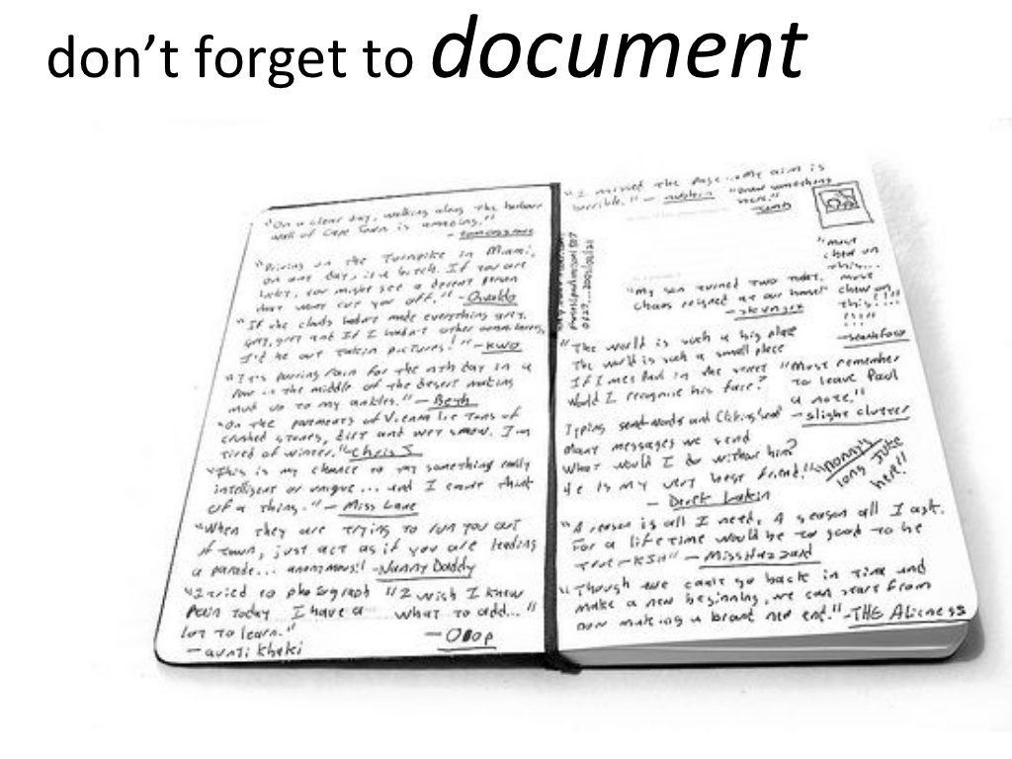


Slide 91



Slide 92

Accident Definitions
Incident
The term incident can be defined as an occurrence, condition, or situation arising in the course of work that resulted in or could have resulted in injuries, illnesses, damage to health, or fatalities. The term "accident" is also commonly used, and can be defined as an unplanned event that interrupts the completion of an activity, and that may (or may not) include injury or property damage.
Injury:
Any physical or functional abnormality or loss which results from a workplace event or occupational disease/illness. Such injuries may result in lost time and/or a requirement for medical aid or first aid.
Lost Time:
Any absence from work (except the date of the incident) as a result of a work-related injury.

Slide 93
Accident Definitions
Critical Injury:
An injury of a serious nature that:
places life in jeopardy;
produces unconsciousness;
results in substantial loss of blood;
involves the fracture of a leg or arm but not a finger or toe;
involves the amputation of a leg, arm, hand or foot but not a finger or toe;
consists of burns to a major portion of the body; or
causes the loss of sight in an eye.
The ministry considers the leg to include an ankle or foot and the arm to include a wrist or hand.
Although the regulation specifies that the fracture or amputation of a single finger or toe is not a critical injury, a fracture or amputation of more than one finger or toe is considered to be a critical injury.

Slide 94
Accident Definitions
Medical Aid (no lost time beyond date of incident):
Professional services provided by a health care practitioner, including services provided by or at hospitals and health facilities such as walk-in clinics, physiotherapy clinics.
First Aid Only:
Health services provided by employees of Home Depot [e.g. A worker sustained a minor injury and the only treatment provided was first aid at the workplace, such as a band aid applied to a small cut , ice applied to bump].

Slide 95
Accident Definitions
Near Miss/Incident Only
A work-related incident without personal injury or property damage, but with the potential for personal injury or property damage [e.g. verbal threats by customer or co-worker, worker slipped on a wet floor without injury – no first aid treatment].
Property Damage
An incident that results only in damage to Home Depot facilities, equipment, tools or vehicles without injury to an employee.

Slide 96
Accident Definitions
Reportable Injuries:
All injuries, whether lost time is sustained or not, must be reported on the Report of Injury/Incident Pronto form. An injury becomes reportable to the Workplace Safety and Insurance Board when:
an employee advises his/her immediate supervisor that a workplace injury has occurred, and that medical attention has been, or will be, obtained and/or
an employee advises his/her immediate supervisor there is lost time beyond the day of injury
All workplace injuries and incidents, whether reportable to the WSIB or MOL or not, will be reviewed with the Joint Health and Safety Committee.

Slide 97
Accident Reporting Procedures
You have a legal obligation to report ALL work-releated accidents immediately.
Use the accident reporting form that’s on pronto.
Include reporting accidents immediately as part of your training process.
If employees start to feel an injury occurring and let you know ahead of time, injuries can be prevented by showing them how to do it properly or alternating tasks or other accommodation.
A supervisor has a responsibility to work with Human Resources when a work-related accident occurs to ensure proper reporting and review of modified duties available before an employee stays home.

Slide 98
Accident Reporting Procedures
When notice is required
Employers must report a work-related accident to the WSIB if they learn that a worker requires health care and/or:
is absent from regular work
earns less than regular pay for regular work (e.g., part-time hours)
requires modified work at less than regular pay, or
requires modified work at regular pay for more than seven calendar days following the date of accident.
Reporting deadline
The WSIB must receive an employer's complete accident report within seven business days of the employer learning of the reporting obligation. (Business days are Monday to Friday, and do not include statutory holidays).

Slide 99
Supervisors of injured employees will:
assure medical assistance, as needed, is provided to the injured worker (e.g. first aid, transport to medical facility, 9-1-1)
immediately investigate all incidents to the extent needed to determine cause and actions needed to prevent a recurrence and to complete all sections of the pronto accident report form.
promptly initiate and/or implement corrective actions within their control to prevent similar injuries/incidents or direct to other parties for action if outside their control
promptly share necessary information with HR so that actions can be taken to prevent future similar injuries/ incidents.
Work with HR (and WSIB if applicable) to arrange modified duties and a return-to-work schedule to minimize the time the employee is off work. This may involve meeting with a RTW specialist at the store to review available duties.

Slide 100
Workers will:
obtain medical treatment (e.g. medical aid, first aid, 9-1-1), if required,
immediately report work-related injuries or incidents to their supervisors, and
complete the Worker’s Report of Injury/Illness (WSIB Form 6) if the injury or illness is reportable to the WSIB and provide a copy to their supervisor and the WSIB
Participate (Where applicable) in the RTW process including modified duties and graduated return to work schedule.

Slide 101
Human Resources and Health and Safety Consultants (Allison & Gina)
Report to the Occupational Health and safety Consultant immediately when they learn of a critical injury,
Using the submitted accident report, complete Form 7s to the WSIB, providing a copy to the worker.
Provide a copy of the Return-to-Work package including Form 8 or FAF for doctor
Act as liaison between the merchandisers, supervisors and the WSIB,
Maintain employee WSIB files.

Slide 102
Human Resources and Health and Safety Consultants (Allison & Gina)
Request additional information of supervisory staff if a Supervisor’s Report of Injury/Incident is inadequately completed,
Assist when occupational health and safety expertise is needed in completing corrective actions identified by the supervisor in the report,
Provide assistance and training in incident investigation and reporting, as needed
Review injury/incident trends to assist in identification and initiation of appropriate prevention efforts.

Slide 103


Slide 104
Living with and Managing Covid-19
What we know about COVID-19 is changing rapidly
The current restrictions surrounding Covid-19 are changing rapidly.
The release of the media document yesterday is filled with good news.
There is also a Home Depot call scheduled for tomorrow which will have more information.
Here is the information currently known that we can share….

Slide 105
Living with and Managing Covid-19 (as of March 10)
Home Depot is NOT requiring the completion of the daily covid screening forms from vendors.
Masks are still a requirement.
Sanitizing stations are still provided throughout HD.
Capacity limits are lifted while Physical Distancing measures are still in place.
Digital Sign In program is a permanent change.

Slide 106
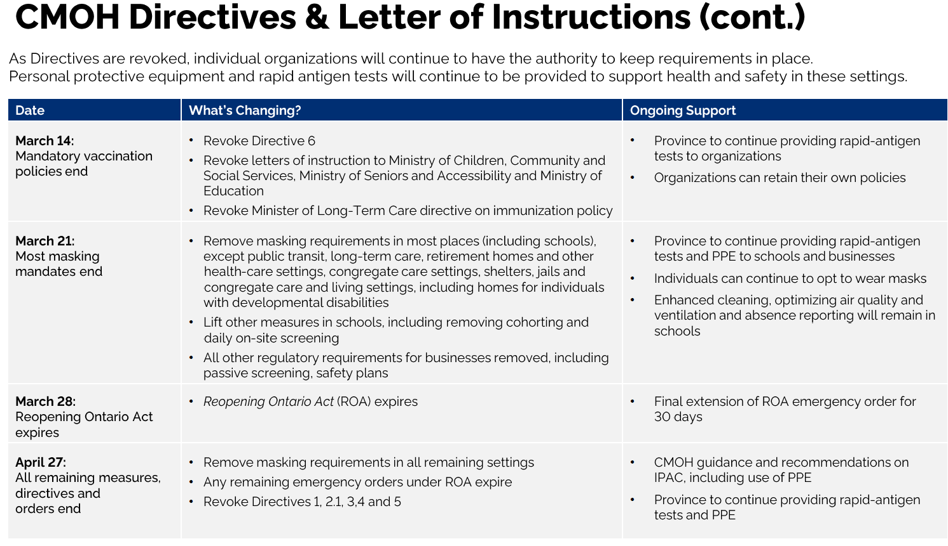

Slide 107
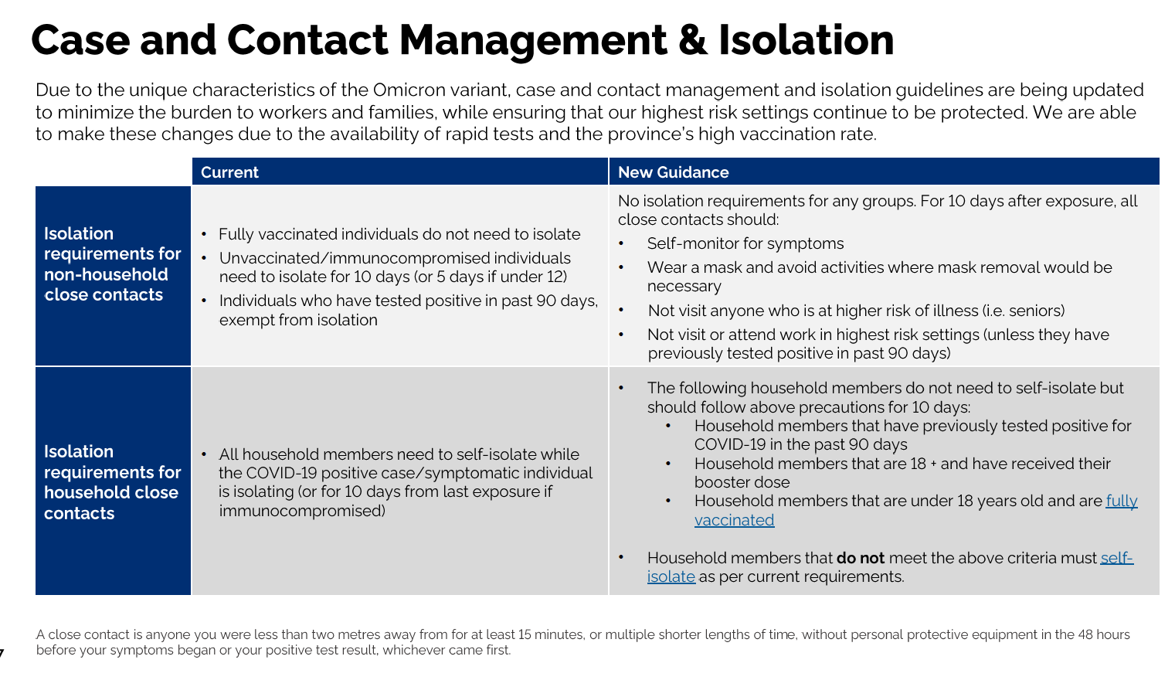

Slide 108
Living with and Managing Covid-19
1. Infection prevention is still key.
2. Once masks are removed, people can still voluntarily wear them, and this must be respected.
3. Anyone who is ill should stay home until they are recovered and able to work again. Unless they are not vaccinated then the isolation rules apply.
4. Because information is so new, we do not have final guidelines to give you now other then what has been provided. We will continue to monitor and once more is known release an updated covid memo to provide to your team.

Slide 109





