Slide 1
Human Resources Best Practices
March, 2022
HIRE BETTER TODAY

Slide 2




Recruitment Trends in 2022
“Time spent on hiring is time well spent.”
Robert Half
“If you can hire tough, you can manage easy.”
Sue Tetzlaff, Author

Slide 3
2022 Trends
Remote Hiring Becomes a Permanent Fixture
Passive Candidates Become a Prime Target
More Selective Candidates-- Candidate-driven market
Diverse Hiring is a MUST have to build a strong team.
Recruiters need new skills for the new world of work
Retention Will Become Even More Important (even for the Season)

Slide 4

Remote Hiring Becomes a Permanent Fixture
The Goal Remains the Same; Hire a Strong Team for the Season
Only the Methods Will Change

Slide 5


Remote Hiring Methods
Screen Resumés Properly
Take Advantage of the Phone Screen
Interview in Person.

Slide 6

Resumé Flags
Saying a lot while saying nothing at all - resumés filled with verbiage but no detail are usually something to be mindful of. You don’t need to discard but do ask more directed questions to clarify details during the interview process.
Ignoring the Basics - resumés with lots of errors usually do not offer the skill sets needed and become problem hires.
Irrelevant references - A good reference list is crucial. It’s a red flag if a candidate’s references are unrelated to the job they’ve applied for or have little experience working closely with them. Because self-selected references are nearly always positive, it’s important to assess the value of each reference to see if they’re illustrative. Ask your candidate about their relationship with each reference to get a better sense of how relevant their references are. In other words, its not necessary to check references, but you should at least ask for a minimum of one professional reference. Who a candidate can provide as a reference is telling in itself.

Slide 7
Benefits of a Phone Screen
Shorter Time to Hire: By conducting phone interviews in the early phase of the interviewing process, employers can save time and money that would otherwise be wasted on meeting unsuitable candidates face to face.
Improved the quality of hire: Phone interviews are primarily used as a screening method which helps an employer eliminate unsuitable candidates for a position.
Tests candidates’ communication skills: Phone interviews are an especially important part of the hiring process for positions that require candidates to communicate with customers. Those who can communicate well on the phone can usually communicate well in person.
Reduced Bias: A properly conducted phone screening interview minimizes the impact of first impressions, thus improving the objectivity of the selection process and reducing bias in recruitment.
Improved candidate experience: Even candidates who don’t select for a face-to-face interview will feel that you’ve given them a chance, time and attention.

Slide 8
Phone Screen Questions
1. Did you apply for the Garden Center Merchandiser Position at __________ location?
2. Where are you currently located?
3. Are you aware of the (insert potential start date) and (length of contract)?
4. Are you currently working? If yes, are you aware this is a temporary position?
5. What is your availability for work? Full time, days etc... Any schedule restrictions?
6. Are you willing to work longer hours during peak periods?
7. Do you have experience (or okay with) working outdoors in a physically demanding position?
8. Why did you apply to the position?

Slide 9


Follow Up
For every phone screen you schedule an interview with, follow up by email confirmation. Thank them for their time, confirm how you will meet next and ask them to reply to your email confirming receipt.
Finish your phone call AND send them an email by asking them the same question - to please do you a favour “IF something comes up and you can’t make it can you please let me know so I can give your time slot to someone else.” These two actions, follow up and a request makes them feel singled out AND WILL reduce your no shows.

Slide 10


The Interview
As March 1, 2022 capacity and vaccination passports have been eliminated. With a current 81.059% of eligible Ontarians having received both dosages, and Omicron steadily declining, there is no need to have a conversation regarding vaccine status.
Review and maintain current COVID-19 protocols in place during the interview process including masking, distancing and sanitizing.
If you feel more comfortable doing your initial screening virtually this is an option. However, it is best practice to always meet in person (safely) before finalizing the hire.

Slide 11
Passive Candidates Become a Prime Target
WHO?
Passive candidates —applicants who aren’t even looking for a job — are people you need to include in your hiring efforts.
Passive candidates haven’t prepared a resume, and their interview outfit needs to be dry-cleaned. They haven’t even bothered to push the Apply button
For a variety of reasons their qualifications and experience make them attractive to hiring managers, who may begin recruiting by inviting considered candidates to consider the position.
Passive candidates are often those with in-demand skills and unique experience, making them desirable to employers, and sometimes difficult to recruit.

Slide 12
Passive Candidates Become a Prime Target
WHY?
Since they are not actively looking for another role, passive candidates may not be interviewing with other companies. Don’t count on this 100% of the time. There are plenty of companies looking for passive candidates. If they are a good candidate, another company may have reached out to them as well, but many times you may be the only other organization they are talking to which gives you an advantage.
You expand your candidate pool from 25% of the workforce to nearly the entire workforce. Expanding your pool will help you include the most qualified candidates that will not be included in the active candidate population alone.
Passive candidates are generally high performers. Research shows that passive candidates are more engaged in their current roles than active candidates, which means they are usually the ones currently making an impact. If you want your next hire to be a high impact performer on your team then you need to be looking at passive candidates.

Slide 13
Passive Candidates Become a Prime Target HOW?
Method 1: Reference your database. If you’ve kept record of your past recruitment methods this is the place to start your search. A candidate who applied in the past may not have been a fit for that role at the time, but they may be the perfect fit for your current role now.
Method 2: Use your contacts. Let people know you are hiring. Use it in conversation, ask them to let others know. The more it is talked about the wider the net is spread. Have a regular customer that you have come to know? Ask them if they are interested.
Method 3: Ask for employee referrals: Let the employees in your team do some of the recruiting for you. They are closely connected to people in their industry, they know your company culture and they can usually provide a rich source of qualified leads.
Method 4: Social Media. Can link company website postings to social media. Ask Human Resources first.

Slide 14
More Selective Candidates-- Candidate-driven market
Candidate-first recruitment practices to implement in your recruitment strategy. This means:
Create a process that makes candidates believe the role you’re offering is the best opportunity for them. Think of recruitment as a “sales cycle” for talent and create an experience top talent cannot resist.
Think about the candidate user experience. Review the application process, provide timely and frequent updates. Provide two-way opportunity at every step. Continually invite candidates to ask questions. Prepare yourself to be transparent and authentic.
Be mindful of candidate’s time when making decisions. Don’t jump to “Hire”. Still go through the steps. But do not drag it out either. Candidates want to be hired and start work yesterday.
Hire for potential, not experience. Target the “total skills market,” looking at applicants who present talent with adjacent skills, candidates whose skills are self-taught,

Slide 15
More Selective Candidates-- Candidate-driven market
Make your processes user-friendly and efficient.
Post jobs on multiple platforms and unique areas. Indeed isn’t a one stop shop anymore! Review your ideas with HR first.
Prompt communication is vital. five days as the optimal communication time, even if it’s to say it’s no news.
Harness technology ~ Use various methods available but maintain professionalism.
Be transparent~ Candidates appreciate employers that are transparent about job duties and other job essentials, so make sure you’re clear about your offerings and expectations.
Be Flexible! What once “always was” isn’t necessarily what “is now.”

Slide 16
What is diversity hiring?
Diversity hiring simply describes the processes of recruiting that supports diversity in the workplace.
Diversity hiring is not about increasing workplace diversity for the sake of diversity. Diversity hiring is all about giving every candidate an equal opportunity, regardless of their background. It’s about identifying and removing any steps in sourcing, screening and shortlisting candidates that may allow discrimination against candidates and personal characteristics that have nothing to do with their ability to do the job such as gender, age, religion, sexual orientation and so on.
By removing biases against individuals or groups of candidates, the process of finding the best candidates to be considered for the role can be based on merit… and all the qualities identified as essential for the role and the organization.

Slide 17
Diversity Hiring
According to Monster research, more than four in five (86%) candidates globally say diversity, equity and inclusion (DEI) in the workplace is important to them.
Additional research found that 62% of people would go as far as turning down a job offer if came from a culture that didn’t support a diverse workforce.
Try to look at candidates who you normally may consider to be an untapped talent.
Diversity hiring is hiring based on merit with special care taken to ensure procedures are free from biases related to a candidate’s age, race, gender, religion, sexual orientation, and other personal characteristics that are unrelated to their job performance.

Slide 18
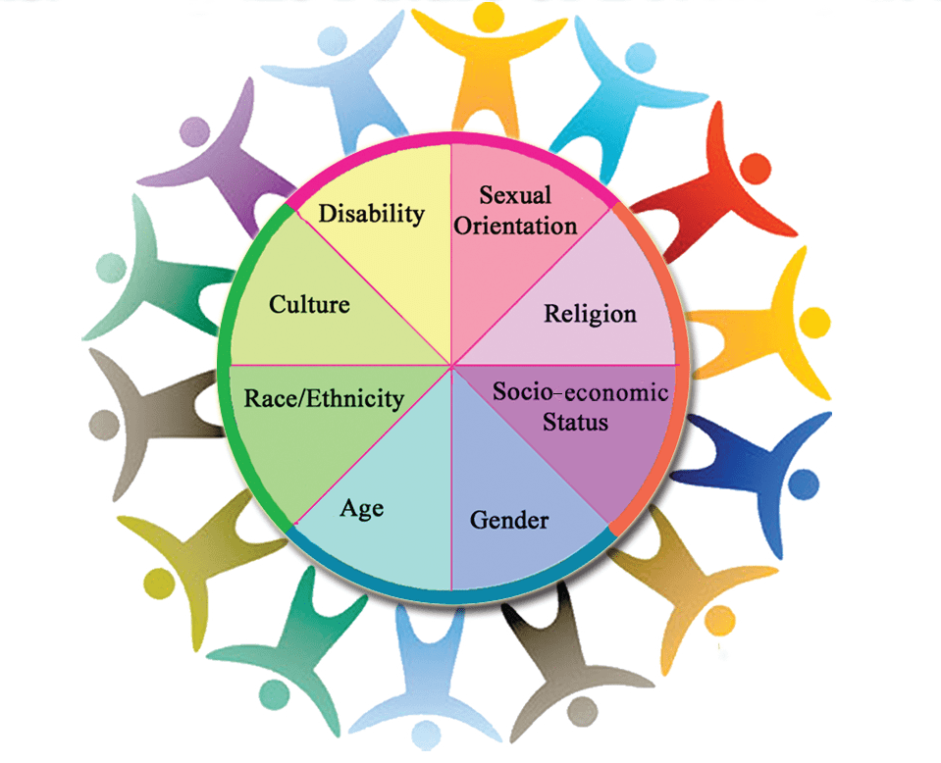
5 Reasons Why Diversity Hiring Matters
1. It Grows Your Talent Pool
2. Improves Employee Happiness, Productivity and Retention
3. It improves innovation and creativity
4. It is positive for the company brand.
5. It increases your workforce’s range of skills, talents & experiences

Slide 19
Recruiters need new skills for the new world of work
Basic Marketing Knowledge--To woo the best talent, recruiters need to know how to sell the job and its perks in the right fashion
Solid relationship-building skills- First person with whom a candidate has contact. Use this to build a relationship with perspective hires. You are selling the job to the candidate. Provide a clear and accurate picture so that the candidate can make an informed decision. Listening actively and empathetically to what candidates, coworkers, and managers are telling recruiters will give them invaluable information on job expectations, working conditions, interpersonal relations, and candidate ambitions.
Quick decision-making~Stay in touch with the market trends and be able to apply their knowledge to make faster strategic decisions about whom to hire and from where to hire

Slide 20
Recruiters need new skills for the new world of work
4. Strong attention to detail~The cost of a wrong hire can be enormous, regardless of which role it is for. Therefore, recruiters need to have the ability to sift through the masses of candidate information, select the most appropriate applicants and make a careful decision after interacting with them. If one does not pay attention to detail, that can lead to a lower quality of hire.
5. Ability to create a positive candidate experience~ Did you know that 69% of applicants would not accept a job with an employer with whom they had poor experience? Recruiters are in charge of creating a positive first impression for the potential hire on behalf of the company. Therefore, it is vital to ensure that the entire recruitment process flows smoothly, is as transparent as possible, and involves appropriately challenging selection rounds.

Slide 21
Recruiters need new skills for the new world of work
6. Exception Communication Skills-Candidates crave communication when applying for jobs. A CareerBuilder survey found that 84% of candidates expect a personal email response acknowledging the company has received their application. Plus, 36% of them expect to be updated throughout the hiring process.
Unfortunately, only 26% of companies inform the candidates about the status proactively. Therefore, recruiters must ensure the applicants they handle are continually updated about where they stand in the recruitment process.
Ghosting them is detrimental to the company's reputation. However, prompt communication is just one part of it. The communications themselves need to be respectful, coherent, informative, and personalized.

Slide 22
Recruiters need new skills for the new world of work
7. Excellent Time Management Skills~ Recruiting involves a lot of back-and-forths and juggling large amounts of data simultaneously, which can be highly stressful unless the recruiter has excellent time management skills. They need to be able to organize their day and their task list so that things happen accurately and on time without being overwhelming.
8. Reliability~ The best thing recruiters can do for both sides is to set realistic goals, keep communicating, and deliver on the promises you make. Both the company and the candidates need to feel like the recruiter is on their side. As mentioned previously, they must always provide interview feedback to candidates and regular updates to hiring managers. Reliability is one of the most important skills recruiters need to thrive.

Slide 23
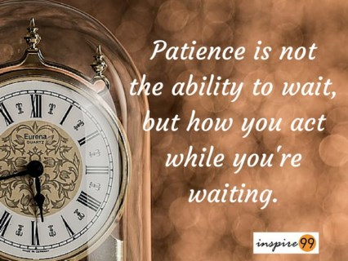
Recruiters need new skills for the new world of work
9. Patience
This may seem obvious, but the process of how to be a good recruiter requires them to exercise patience during the recruitment process. There are multiple candidates to follow up with and schedule interviews with, which can naturally get stressful at times.
However, the best recruiters know how to keep any impatience in check when speaking with candidates. Plus, bear in mind that the pandemic has been stressful for everyone, so a bit of patience goes a long way.

Slide 24

Conclusions Regarding New Skills For Recruiting
The business world is in a constant state of flux, and new technologies and hiring preferences can emerge at any time. Recruiters need to be able to adapt to these changes quickly and take them in your stride, which is why these recruitment skills are a must-have!
Don’t Forget
Lots of training resources are available with HR Downloads. Talk to HR about what areas you are interested, and webinars can be assigned to your library for you to take. There’s also articles and other material available. Just ask!

Slide 25
Retention Will Become Even More Important
(even for the Season)
Managing for employee retention involves strategic actions to keep employees motivated and focused so they elect to remain employed and fully productive for the entire season.
It is more efficient to retain a quality employee than to recruit, train and orient a replacement employee of the same quality.
Fairness and transparency are fundamental yet powerful concepts that can make a lasting impression on employees
Retention = Job Satisfaction from your employees. Its important to understand Job Satisfaction and how to achieve it.

Slide 26
Retention Will Become Even More Important
(even for the Season)
Proven Ingredients for Job Satisfaction:
1. Communication~ Communication can be extremely important to retaining levels of satisfaction, on both a personal and professional level. It is exhibited in allowing employees to be open, collaborative, trustworthy, and even confrontational when needed.
2. Culture~ Defining a company culture links to job satisfaction as it provides values and guidance about topics ranging from organizational goals to appropriate levels of interaction between employees.
3. Leadership~ when employees feel that leaders can guide them through tasks, their motivation and satisfaction increases.
4. Working conditions~ Job satisfaction can be increased if a resilient workplace is a cooperative environment. This means a place with respect for diverse ideas and opinions, honest and constructive feedback, mentoring opportunities, and freedom from harassment
5. Recognition~ Recognize good work. 63% of employees feel like they don’t get enough praise. This job satisfaction statistic reveals a huge opportunity for leaders to step up and make their employees proud of their work. Give feedback often and workers value the time you took to do so. Especially when its constructive.

Slide 27
Orientation Processes
Everything stays the same. There are no shortcuts in a pandemic.
All hiring processes must be followed.
All orientation processes must be followed.
New hires (including re-hires IF they missed a season) must have full orientation completed prior to start date. NO exceptions.
Re-hires can have a condensed orientation version but also must be completed prior to first day in the stores.
ALL must receive the full covid training in addition to the previous requirements.

Slide 28
Seasonal Contracts
Remember these are seasonal termed contracts. Returning workers are a bonus but they are each individual contracts. Its important to understand and use the proper terminology.
Must be completed prior to first day in stores-can be done at in person interview.
New pay rate is $15.50/hr for new hires and $16.00/hr for returning. No further increases will be considered.
These are legal documents. Please ensure accuracy when entering.
Common contract errors: NO SIN number should be entered
Must be in candidates legal name (no nick names)

Slide 29
Training
All training is paid time and must be done prior to working in the store. If they have an accident on the job, and this isn’t done, we haven’t done our due diligence.
Use the checklist provided to track your document submission. This is your responsibility.
Please send in documents by employee, do not mix any scans as this makes it difficult for electronic filing.
Ensure all documents are completed prior to signing.

Slide 30
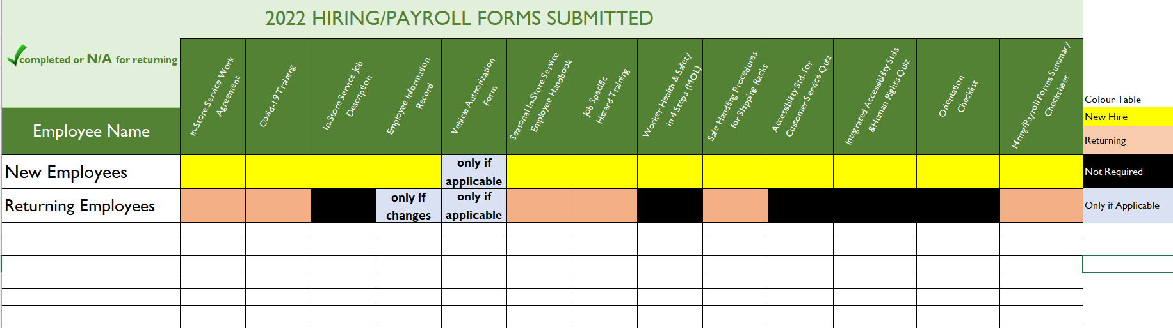
Required Training
“Confidence comes from discipline & training.”

Slide 31

Documentation: Human Resources
It demonstrates professionalism
It provides helpful guidance for performance
Ensures the entire Onboarding process has been done correctly.
Keeps you on target (deadlines and goals).
Legal compliance.

Slide 32
Due Diligence
Due diligence is the level of:
What a person would reasonably be expected to do under specific circumstances
Judgement
Care
Prudence
Determination
Activity

Slide 33

The Secret Diary
If its important enough to discuss,
its important enough to write down.

Slide 34
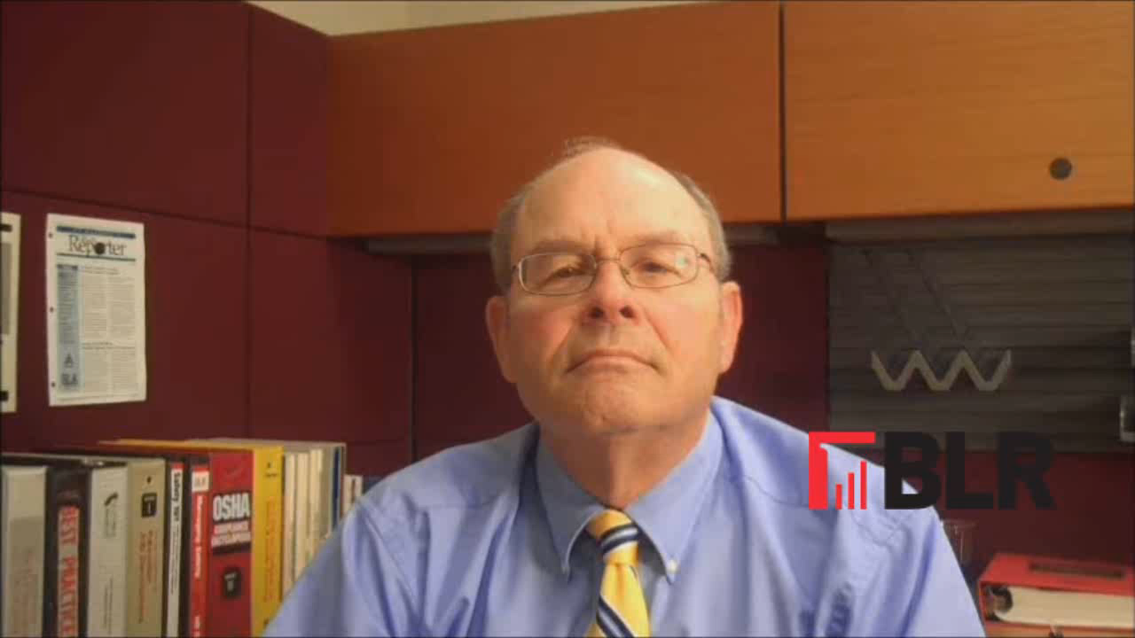

Slide 35
Training
For re-hires, do as much training as possible via phone. (handbook review, rack handling video, customer service, MOLTSD Awareness Certificate, Covid-19 training)
Meet with new hires at the store or in the garden centre to go over the pronto forms and any in-person training.
(Sanitize hands prior and after phone usage & keep physical distance.)
Have the employees access the documents via the website.
Those who are able can use adobe fill and scan to complete and send the training forms.

Slide 36
Covid-19 Training
All merchandising representatives must complete Covid-19 training as part of the orientation process. This includes;
Viewing the Covid-19 Home Depot/Jeffery’s presentation on the website. (To be updated after March 11 Phone Call)
Reviewing the Jeffery’s Covid-19 Merchandising Memo.
Completing the Record of Training form

Slide 37
Remember!
Never send ANY personal information by email! This includes;
SIN number, Driver’s License, Banking Info, Health Card.
Use the secure document transmission button on the website when not including on the prontoform directly.
Phase 1 of Advertising has begun. Phase 2 will go live the week of March 21.
Be mindful of how early you hire. Unless its very selective, targeted hiring, the random person is not willing to wait long to start working. Work with Brian to target when it is appropriate to start hiring. Most hiring will occur March 21st onwards.
Once you have a more final summary of who is returning, please send into HR.

Slide 38



Call Human Resources
if any questions or to ask for help
“Blossom by blossom the spring begins.”
A.Swinburne

