Slide 1

Recruitment During a Pandemic
Human Resources Strategies
March 12, 2021

Slide 2

The Goal Remains the Same; Hire a Strong Team for the Season
Only the Methods Will Change

Slide 3

Recruiting Trends in 2021: Trends you’ll want to sharpen up on

Slide 4


Recruiting with Flexibility
Hiring outside your Target Market
Video Recruiting
Diversity Hiring
Reassurance-Candidates will continue to need assurance that workplaces are safe

Slide 5
Recruiting with Flexibility
A competitive hiring market means offering perks to employees, including one that’s increasingly prioritized by job seekers: Flexibility.
Main Flexibility Option for Seasonal Contracted Positions is Scheduling: Being adaptable with scheduling will help attract candidates. Options to consider include;
Flex time: Flex time is an arrangement where employees work a full day but they can vary their working hours.
Reduced hours/Part-time: Employees may choose to work fewer than the standard 40 hours work week. Some times filling a full time position will require hiring two great candidates instead of one.
Act, Don’t React: Don’t rely on demand to put schedules together. Plan the schedules needed to get the work done and communicate that in advance to your employees. Things may change but try as much as possible to be consistent.
Notes:
These arrangements may include specific guidelines so that a "core" working day exists. Flex time is usually arranged in advance with the employee and employer or supervisor and a set range of start and finish times are established. The total hours of work are not usually affected by this arrangement.

Slide 6
Recruiting with Flexibility
Regardless of the flexible arrangement made with your newly hired employee, all agreements should include both expectations and deadlines.
These should be clearly be outlined by the supervisor and agreed upon by both the supervisor and the employee.
Supportive organizational culture, clear communication, teamwork and reciprocal support between management and employees will help ensure the success of these initiatives.
If you utilize a flexible arrangement to hire a qualified candidate enlist the assistance of Human Resources to make sure it is done properly.

Slide 7
Hiring Outside Your Target Market
The shortage of workers who are traditionally qualified for specific jobs means employers will continue to look outside their traditional target markets.
This means hiring will not necessarily be based on prior job experience but based on the candidate’s potential for growth and the ability to be trained quickly and on the spot.
Employers will also need to look for skills they think will help prospective employees easily adapt to the responsibilities of the job — otherwise known as transferable skills.
Transferable skills can include things like dependability, strong communication skills, organization, adaptability and leadership.

Slide 8
Video Interviewing is no longer just a nice-to-have—it’s an essential part of your recruitment strategy.
What is a video interview? It’s an interactive dialogue between at least two people that takes place remotely using video technology.
Both the recruiter and candidate can participate in the interview using a desktop or mobile device with an internet connection, a camera, and a microphone.
Most hiring professionals see the greatest benefits with video interviews for applicant screening.
Note: There must be accessibility offered with candidates, if they do not have technical access or ability then conduct by phone.

Slide 9

Here’s what a typical process would look like for video
interviewing:
POST A JOB AD AND RECEIVE APPLICATIONS
REVIEW THE PROVIDED INTERVIEW QUESTIONS
DOCUMENT THE VIDEO INTERVIEW ANSWERS
REVIEW THE CANDIDATES VIDEO ANSWERS
INTERVIEW ONLY THE TOP CANDIDATES FACE TO FACE-CAN. DO CONTRACT AT THIS MEETING IF ABLE TO MAKE IMMEDIATE DECISION.

Slide 10


Slide 11

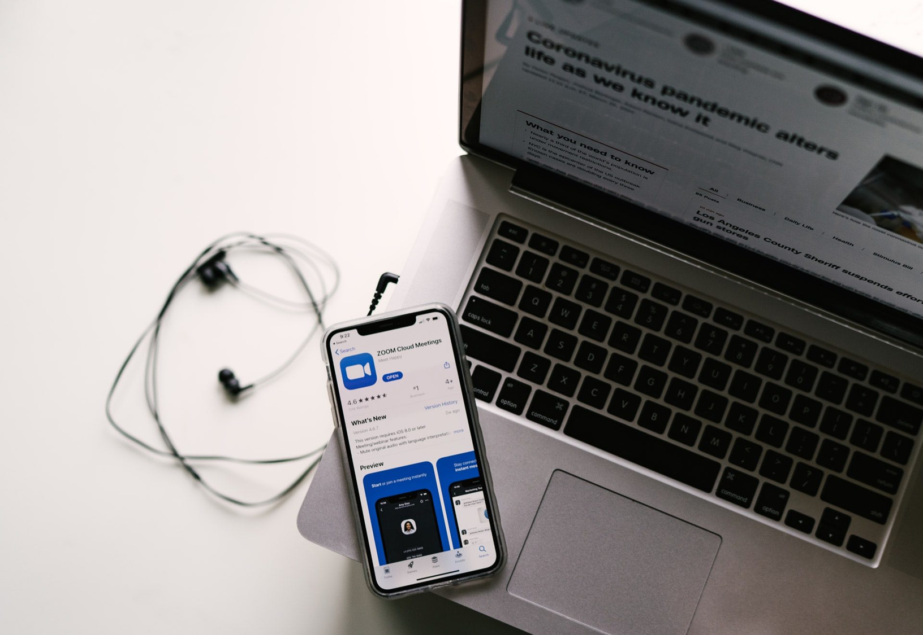
Recommend Using Zoom for all Video Interviews:
It’s the most user friendly video chat app available.
The free 40 minutes has been more then sufficient for all interviews done thus far.
However, if you require longer time, just instruct the candidate to log in using the same link.
Zoom Basics YouTube Video found here will demonstrate everything you need to know if you are not familiar with the platform by now. Gina will make sure the app is downloaded on all your phones.
Set up the meetings ahead of time and send the candidate the zoom link. Watch your time zones!

Slide 12

Microsoft Teams app (unlimited time for meetings):
Or you can use your Microsoft Teams app on your cell phone
Log into the app using your email address and Microsoft mail password
Select the Calendar icon at the bottom of the phone ; then select the + to add a meeting in your schedule
The New Event screen will come up where you can add the title, participants (email address), the start and end time of the meeting, and click Done
This will send an email to the recipient with a link to the Microsoft Teams meeting
It will go back to your Calendar screen and if you scroll to the day that you set the meeting, you will see it listed with a “ Join Button” so that you can start the meeting

Slide 13
How to conduct a video interview: 5 tips & tricks
1) Pay Attention to Details: Before you start the meeting, take a moment to look around the room. How’s the lighting? What’s in the background? Set the camera at eye level, and make sure the light doesn’t come from behind you. You’ll also want to dress accordingly to appear professional and give off the right impression. And stay away from any bright designs or patterns that can be distracting on camera. Is your furry friend secured?
2) Don’t rush: A video interview does take less time but that doesn’t mean you need to rush the process. Take your time and be thorough.
3) Set the right tone: With your interview questions, you set the tone for the candidates’ responses. Keep your questions simple and to the point, so that candidates can stay on track.
4) Clarify your expectations: Video interviews help create a smooth candidate experience—as long as you make your expectations clear. Let the candidate know the agenda.
5) Invite candidates to ask questions: Giving candidates a chance to ask questions not only shows you care about their concerns—it also helps you identify stand-out candidates. Asking insightful questions is an important way candidates can distinguish themselves from the competition.

Slide 14
Interview Reminders
Contact HR for assistance as needed
HR will continue to facilitate all postings but work in partnership with each supervisor to expand advertising beyond just Indeed.
Only use the posting provided, if a shorter version is needed ask HR to create.
Only use your Jeffery’s email address or company phone for all contact.
Only ask the same questions to each candidate and document properly!
Offer and provide accommodation for the interview
Share the job description properly! Send to them by email ahead of the interview so they have time to review it!
Confirm they can do key elements of the position
Make sure interview questions comply with the Ontario Human Rights Code
Make non-discriminatory hiring decisions.

Slide 15

Interview Goals
Give you an opportunity to meet job candidates face-to-face
The job of the interviewer is to ask questions and listen for predictive information from candidates. Candidates should do approximately 80% of the talking, interviewers 20%.
Helps you to assess a candidate’s strengths, weaknesses, and suitability for the job
Provide you with the information you need for making the best hiring decisions
To provide information about the organization and “sell” the position.
To determine proper fit:
Job: Knowledge, Skills and Abilities
Schedule Availability

Slide 16

Interview Don’ts
Do not ask discriminatory questions
Do not ask personal questions
Do not allow superficial impressions to influence your decision
Do not allow new recruiting procedures (Video Interviews, Physical Distancing) to influence your decision.

Slide 17
Do Remember….
Probing or follow up questions will encourage further conversation. These questions can elicit useful information beyond rehearsed responses. Basic example:
“Can you provide more detail on that?” or “Then what did you do?”
Give an expected start date for the job
Describe the next steps
End each interview with follow up. “I will make a decision in (blank) days.. and commit to getting back to every candidate who takes time to interview with you. Even if its an email thanking them for their time but saying you’ve hired another candidate. (sample emails will be provided).
Thank candidates for meeting with you.

Slide 18

Notes should be factual
Avoid any opinions or personal biases
Include job-related information only
Keep notes on file for at least 6 months
Interviews are an essential part of the hiring process
You need to be a skilled interviewer
You must be able to plan, conduct, and evaluate interviews with job candidates

Slide 19

Keep in mind that the job is of physical nature, make sure this is very clear in the job interview.
Be sure to clearly outline schedule expectations.
Clarify that regular communication is necessary for the job. Access to email and/or phone are great ways to be successful in these positions!
Don’t leave anything “hidden” . No Surprises = A Happy Hire!

Slide 20
Diversity Hiring
According to Monster research, more than four in five (86%) candidates globally say diversity, equity and inclusion (DEI) in the workplace is important to them.
Additional research found that 62% of people would go as far as turning down a job offer if came from a culture that didn’t support a diverse workforce.
Try to look at candidates who you normally may consider to be an untapped talent.
Diversity hiring is hiring based on merit with special care taken to ensure procedures are free from biases related to a candidate’s age, race, gender, religion, sexual orientation, and other personal characteristics that are unrelated to their job performance.

Slide 21
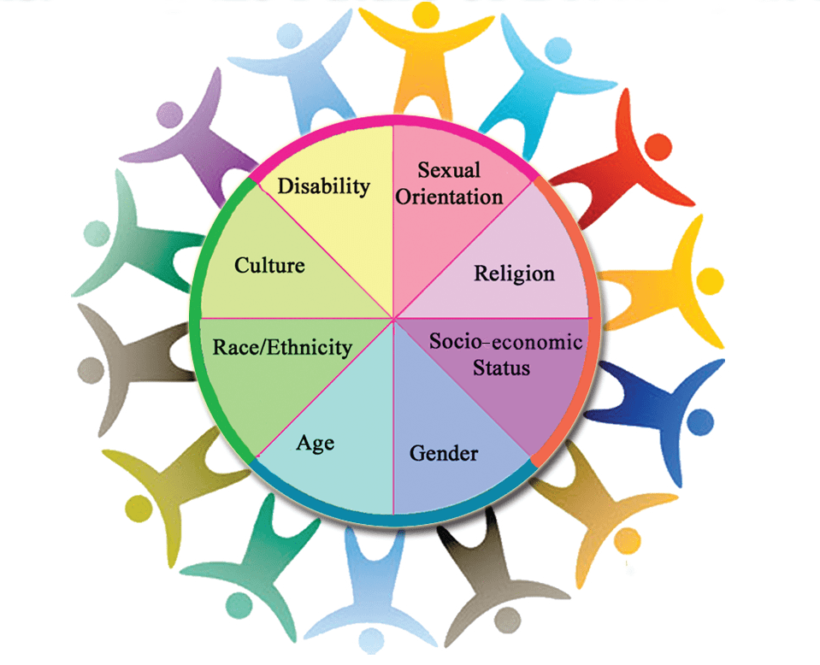
5 Reasons Why Diversity Hiring Matters
1. It Grows Your Talent Pool
2. Improves Employee Happiness, Productivity and Retention
3. It improves innovation and creativity
4. It is positive for the company brand.
5. It increases your workforce’s range of skills, talents & experiences

Slide 22

Diversity Hiring

Slide 23
Reassurance-Candidates will continue to need
assurance that workplaces are safe
Make sure to include in your recruitment process all measures that are being taken to ensure a safe working environment during a pandemic.
Review the covid-19 procedures that have been implemented with each candidate so there are no surprises (high level)
Disposable 3 Layer masks must be worn at all times.
Daily covid screen check form.
No expectation to come into work sick or presenting symptoms.
Sanitizing procedures are in place in Home Depots.

Slide 24

Call Human Resources
if any questions or to ask for help

