Slide 1

Health and Safety Presentation
Jeffery's Greenhouses
Spring Training
Merchandisers
April 13th 2017

Slide 2
A-2 Health & Safety Objectives- Plant II
The Health & Safety Objectives of Jeffery’s Greenhouses Plant II for the current calendar year (2017) are as follows…
1) We wish to maintain our Lost Time Injury (LTI's) Frequency Rate of zero.
2) To reduce our Non-Lost Time Injury (Medical only) Frequency Rate to zero.
From the fall 2016 meeting there were no changes to the accident report.
So far to date for 2017, there has been zero lost time injuries.
There was one non-lost time injuries (medical).

Slide 3


Slide 4
Objectives to achieve these goals are as follows:
Continue working on completing items on our Continual Improvement Plan (CIP) from our 2016 Health & Safety Audit. (See 2016 CIP)
Improve employees' awareness of their surroundings while working. (Promoting S.A.F.E (Staying in Control, Aware of Surroundings, Follows Rules, Exhibit Caution)
Reduce the risk of injuries to our Merchandising Staff. (walk through inspection of Home Depot pop up garden centre and providing safety talks to supervisors promoting safe work habits). (Plant II)
Train employees with regular safety talks which focus on common hazards. (pinch points, slips and falls, eye safety, overexertion)
Promote eye protection with use of safety glasses and sunglasses where appropriate. (signage and spot checks)

Slide 5


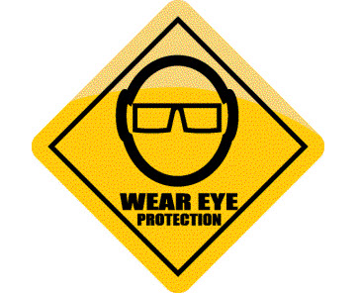
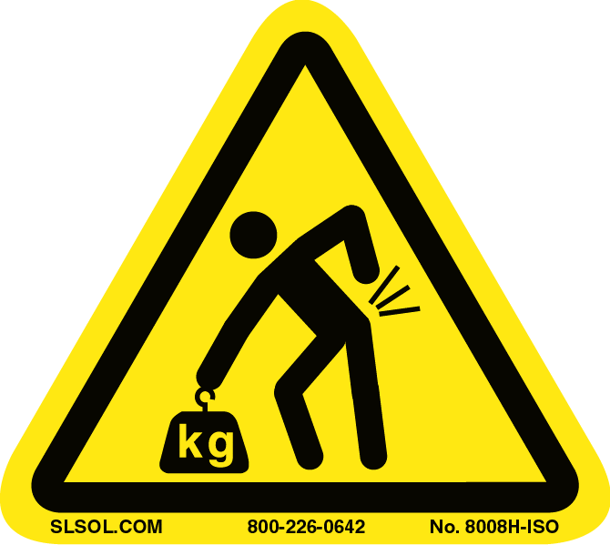
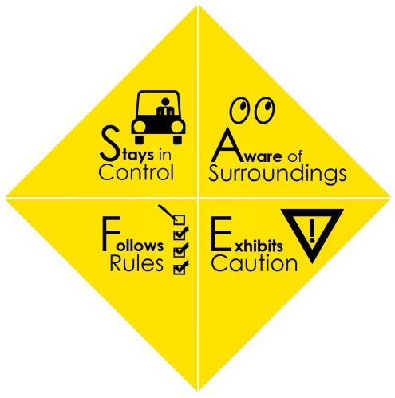
Hazard Focus
Pinch Points
Trip and Falls
Eye Protection
S.A.F.E
Overexertion

Slide 6
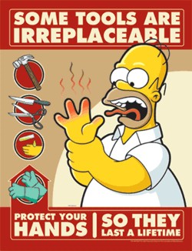
Pinch Points
A Pinch Point is produced when 2 objects come together and there is a possibility that a person could be caught or injured when coming in contact with that area.
Pinch points commonly impact fingers / hands, but can impact any area of the body. The injury resulting from a pinch point could be as minor as a blister or as severe as amputation or death.
Conveyors, gears, loaders, compactors and other moving equipment are examples of machinery with pinch points.

Slide 7


Pinch Points
Questions to Generate Discussion
What are the most common sources of pinch points in your work area?
What improvements can be made?

Slide 8
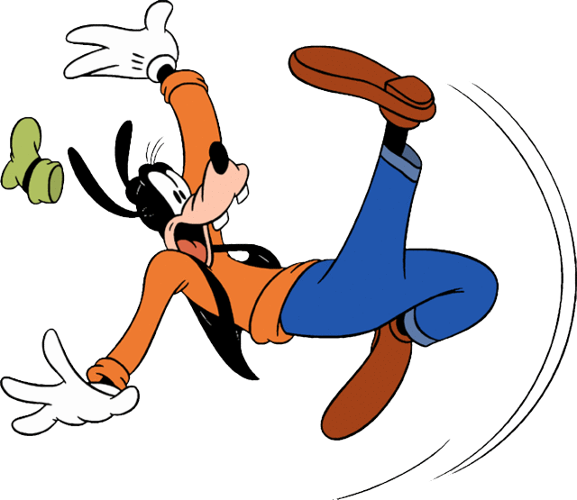
Trip and Falls
Why is prevention of slips, trips and falls important?
In Canada over 42,000 workers get injured annually due to fall accidents. This number represents about 17% of the "time-loss injuries" that were accepted by workers' compensation boards or commissions across Canada (based on statistics from Association of Workers' Compensation Boards of Canada, 2011).
Video

Slide 9
Slips
Slips happen where there is too little friction or traction between the footwear and the walking surface.
Common causes of slips are:
wet or oily surfaces
occasional spills
weather hazards
loose, unanchored rugs or mats
flooring or other walking surfaces that do not have same degree of traction in all areas
Trips
Trips happen when your foot collides (strikes, hits) an object causing you to lose the balance and, eventually fall.
Common causes of tripping are:
obstructed view
poor lighting
clutter in your way
wrinkled carpeting
uncovered hoses or cords
bottom drawers not being closed
uneven (steps, thresholds) walking surfaces

Slide 10
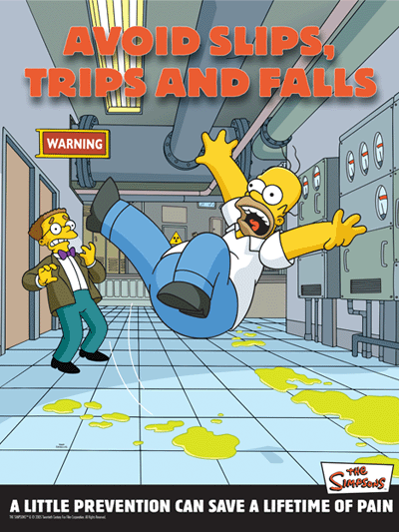
How to prevent falls due to slips and trips?
Both slips and trips result from some a kind of unintended or unexpected change in the contact between the feet and the ground or walking surface.
This shows that good housekeeping, quality of walking surfaces (flooring), selection of proper footwear, and appropriate pace of walking are critical for preventing fall accidents.

Slide 11
Housekeeping
Good housekeeping is the first and the most important (fundamental) level of preventing falls due to slips and trips. It includes:
cleaning all spills immediately
marking spills and wet areas
mopping or sweeping debris from floors
removing obstacles from walkways and always keeping them free of clutter
securing (tacking, taping, etc.) mats, rugs and carpets that do not lay flat
always closing file cabinet or storage drawers
Without good housekeeping practices, any other preventive measures such as installation of sophisticated flooring, specialty footwear or training on techniques of walking and safe falling will never be fully effective.

Slide 12

Questions to Generate Discussion
What can you do to avoid falling at work?
How can you reduce the risk of slipping on wet flooring?
What can you do to reduce the risk of tripping?

Slide 13
You can reduce the risk of slipping on wet flooring by:
taking your time and paying attention to where you are going
adjusting your stride to a pace that is suitable for the walking surface and the tasks you are doing
making wide turns at corners
You can reduce the risk of tripping by:
keeping walking areas clear from clutter or obstructions
keeping flooring in good condition
always using installed light sources that provide sufficient light for your tasks
using a flashlight if you enter a dark room where there is no light
ensuring that things you are carrying or pushing do not prevent you from seeing any obstructions, spills, etc.

Slide 14
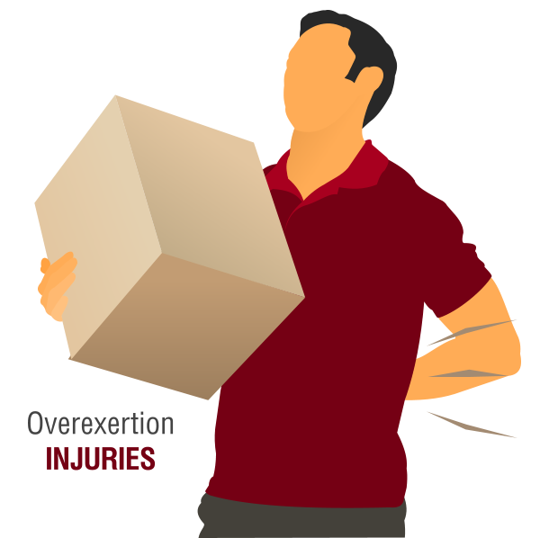
Overexertion
Overexertion is spraining a ligament or straining a tendon or a muscle and occurs when the amount of work attempted exceeds the limits of the body parts doing the work.
Those with a pre-existing condition, limited mobility, or aging limitations are more prone to overexertion injuries. In some cases individuals will overuse one body part to compensate for the limitation of another body part.
video

Slide 15
An overexertion injury is likely to occur in four ways.
High force demands. This can happen when lifting, pushing, pulling, carrying, gripping, and using tools.
Awkward or stationary posture. This can occur when bending, twisting, reaching, and kneeling.
Repetitive movements or actions. Doing the same motion repeatedly without taking a few small rest breaks can cause this.
All other overexertion hazards. This includes contact stress, hand-arm vibration, whole-body vibration, hammering with hand, and working in cold temperatures or hot environments.

Slide 16
The best way to prevent an overexertion injury is to work through the task in your head to figure out the way to best perform the work with the least amount of energy and then follow through with the plan by taking necessary precautions. A major precaution includes using proper lifting guidelines.
•Get a good grip. Grasp the load firmly. Use gloves if they allow for a better grip.
•Get a good footing. Center body weight to provide a powerful line of thrust and good balance.
•Keep it close. Grasp the load firmly and lift towards the belt buckle. Hold the load close to the body to avoid putting pressure on the back.
•Lift smoothly. Raise, carry, and lower the load smoothly. Never jerk a load.
•Avoid twisting. If turning is required while lifting or carrying a load, turn the feet and body instead of twisting the back.
•Push. Push rather than pull the load.

Slide 17
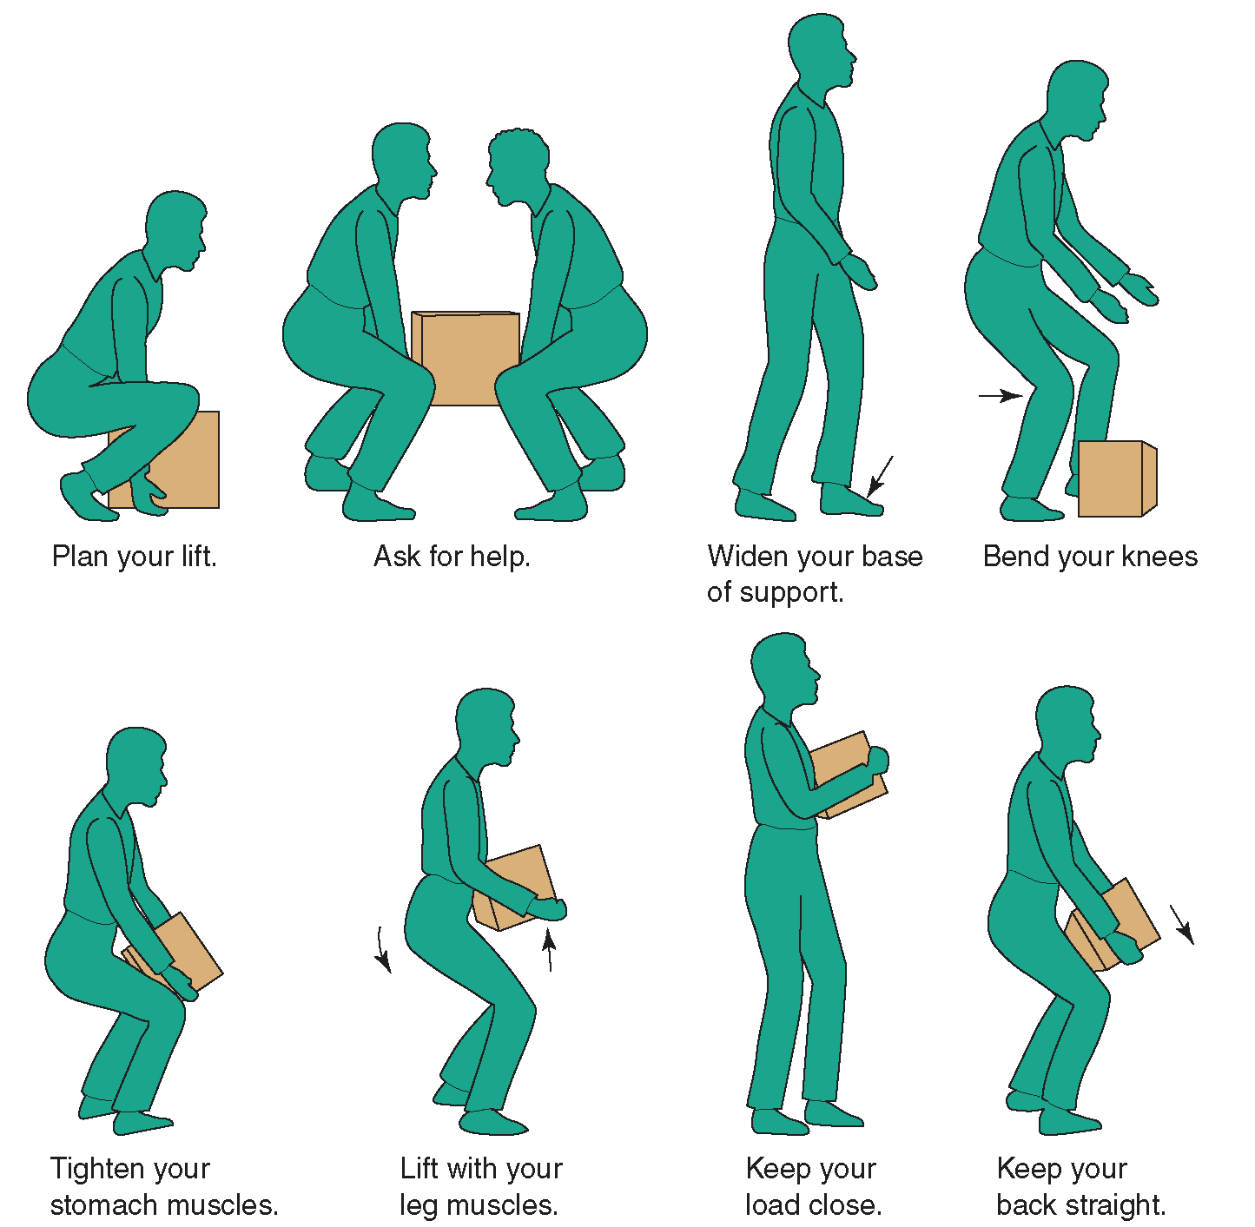

Slide 18

Questions to Generate Discussion
What tasks in your workplace require the greatest amount of forceful exertion?
What types of awkward postures are required in tasks performed in your workplace?
What types of tasks or conditions in your workplace require rapid exertions or applications of force?
Brainstorm and discuss possible areas for improvement.

Slide 19
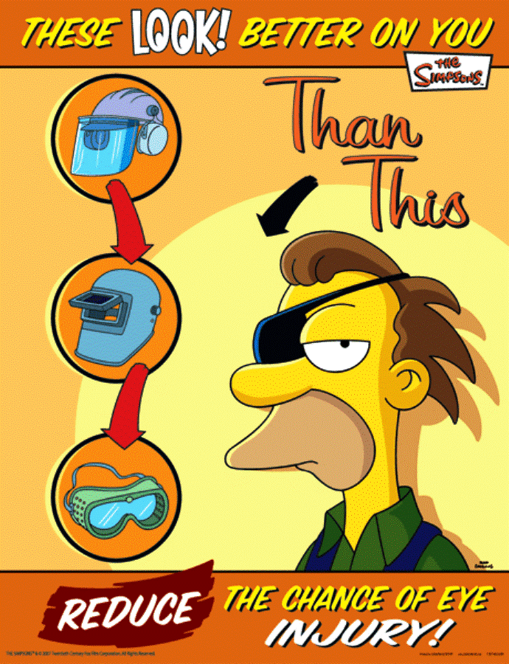
Eye Protection
You’ve only got one pair of eyes. Make them last
a lifetime.

Slide 20
Most Eye Injuries Can Be Prevented by
Wearing the Right Protection!
Know the eye safety dangers at your work.
Never wear contact lenses. Dust and particles can get under the lens.
If you must wear contact lenses for medical reasons then wear appropriate eye protection as well.
Match eye protection to the hazard. Goggles that protect you from dust may not protect you from splash or radiation.
Make sure your eyewear fits you properly.
Keep your safety eyewear in good condition and have it replaced if it becomes damaged.

Slide 21

Questions to Generate Discussion
What are the primary hazards for which you use safety glasses or sunglasses?
How can eye hazards be reduced in the workplace?

Slide 22
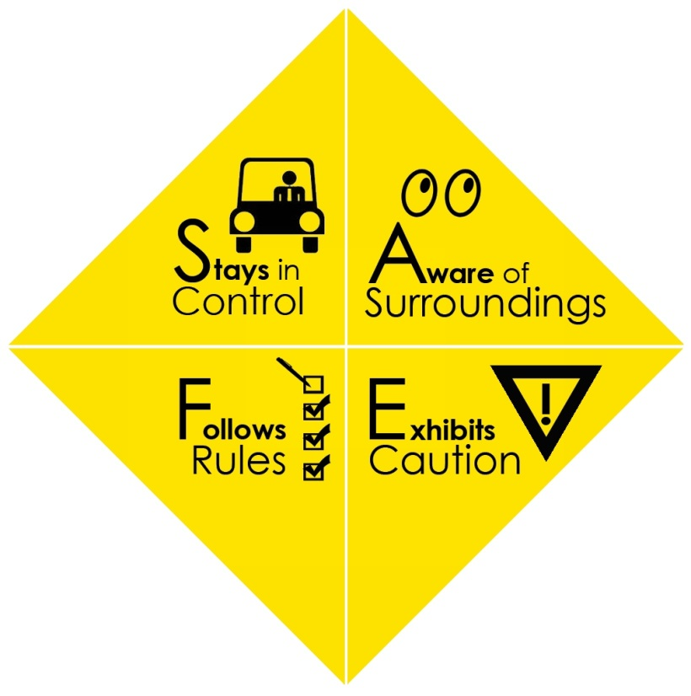
Working S.A.F.E
Employees who demonstrate high awareness of their work environment are much less likely to experience a safety incident than those who demonstrate a low awareness of their work environment because they tend to notice potential safety hazards on the job and stay focused on their job tasks when distractions occur.

Slide 23
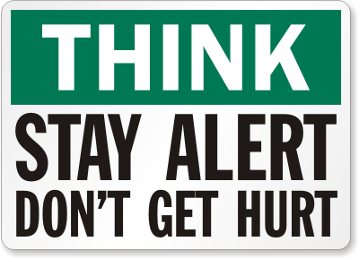
There are many simple techniques and behaviors that can help employees display better Awareness of Surroundings. Here are a few:
•Survey your work area before doing anything.
•Keep your eyes on path, and monitor what is happening to your sides and behind you.
•Learn to observe and notice changes to the work environment.
•Make checklists to be sure that all steps in completing a job task are followed.
•Complete tasks one at a time.
If you do not recognize the hazard, you cannot control the hazard. If you cannot control the hazard, you cannot prevent the injury.

Slide 24
Improve your situational awareness
Get in the habit of regularly pausing to make a quick mental assessment of your working environment. When doing so, consider the following questions:
Is there anything around you that poses a threat to your health and safety and if so, to what extent?
Is the threat big enough that you should stop working?
Is there anything you can do to safely reduce that threat in order that you can carry on working safely?

Slide 25
Merchandiser Specific
Safety Talks
Ladder Safety
Retail Housekeeping-Aisle Ways
Preventing Cutting Injuries
Sun Protection- Glasses
Rack Handling-Glove usage
Shop Lifting-Theft

Slide 26
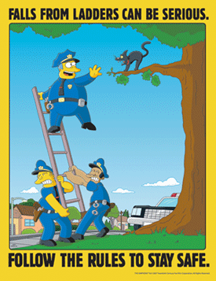
Ladder Safety
If possible, brace yourself with your free hand.
Check ladder before you use it to make sure no parts are missing or broken.
The top two steps and bucket shelf of a step ladder are NOT safe to stand on. If you need this height then you need a longer ladder!
Fully open ladder and place on a firm, level surface.
Keep your weight balanced. Do not reach to the side.
Make sure areas around the base and top of ladder are clear from obstructions!

Slide 27
Preventing Falls
Using inappropriate equipment to access stock at higher level can result in workers falling.
This can result in fractures, broken bones, paralysis or death.
Use the appropriate equipment for the task (eg. Do not use a step stool if a step ladder will make it safer to place or retrieve items at height).
Ensure you do not overreach and your feet remain flat and firm.
If your balance is compromised, you may fall.
To prevent or reduce the risk of falls from height, follow the safety rules, use the appropriate, Home Depot approved equipment.

Slide 28
Retail House Keeping
Aisle Way Clean Up
Housekeeping is critically important to the success of a retail store.
From a customer perspective, good housekeeping standards “speak louder than words.” Many customers will judge if they will enter or return to a store based on the visual appearance of an operation.
Merchandise should be in good condition and fit adequately on the shelf. Overcrowding of merchandise on a shelf or display base can contribute to more falling merchandise and increased injuries and damages.
Clean up as you go. Do not leave a trail of debris behind you.

Slide 29
Display safety and housekeeping checklist
• Is the area around displays and fixtures clutter free and cleaned regularly?
• Are warning signs placed to alert of a hazard that cannot be removed immediately?
• Are walkways and aisles clear and free of storage?
• Is heavier merchandise positioned on LOWER shelves?
• Are displays overloaded or overcrowded?
• Are merchandise cords secured to prevent tripping incidents?

Slide 30

Preventing Cutting Injuries
Be careful with cutting tools such as knives, box cutters and scissors.
Only use tools and equipment you have been trained to use safely.
Use the right cutter for the job and make sure its sharp.
Cut away from yourself.
Keep blades closed when not in use.
Store cutting tools separately and securely– do not leave out for a member of the public to pick up!
Consider replacing old box cutters with new ones that have self-retracting blades.

Slide 31
Rack Handling-Glove Usage
When moving a shipping rack it is important to:
Stand off to the side of the rack standing about a foot or so ahead of the rack.
Pull the rack with your arm reaching back.
Always make sure the toe-bar is in the upright position.
Do Not push the rack from behind (soil from the shelves could possibly get in your eyes).
Make sure your feet are far away from the wheels!
Use gloves when moving racks to avoid hand injury.

Slide 32
Sun Protection
At some point, we’ve all been burned by the sun. Video
Sunburn is the effect of ultraviolet (UV) radiation on the skin. Ultraviolet light is beaming down onus every day, and always has. But now there’s less protective ozone in the atmosphere and risks of exposure have increased.
UV rays are more powerful than visible light rays. They’re so powerful that they can cause cancer.
Ultraviolet radiation can also cause cataracts, other eye damage, and premature aging of the skin.
When you work in the sun, especially in spring and summer, you need to minimize the hazards of UV exposure.

Slide 33
Identify Controls
Wear a shirt and long pants to cover most of your skin.
Protect the rest of your skin with sunscreen.
Use SPF 30 or higher. Follow the instructions about how often to reapply. Don’t forget your ears. The more you sweat, the more often you need to reapply sunscreen.
Protect your eyes. Wear safety sunglasses if the tint doesn’t interfere with your vision. (Most safety glasses—clear or tinted—decrease your UV exposure.)
SPF stands for Sun Protection Factor. Multiply the SPF number by 10 to know how many minutes you can stay in the sun without burning.
Use a UV-blocking lip balm too.

Slide 34

• Remember: Sunlight doesn’t have to be direct to do damage. Light reflected off surfaces such as sand, water, concrete, and snow can also cause UV exposure.
• Sunscreen should be standard equipment for anyone working outdoors during spring and summer. Keep a bottle handy in your toolbox.
Did you know?
Weather reports now include a UV index. This gives you an idea of how intense the ultraviolet radiation will be under clear sunshine or light cloud. When the index is high (7 or higher) you can get sunburned in only 15 to 20 minutes. The highest exposure of the day is from noon
to 2 pm.

Slide 35
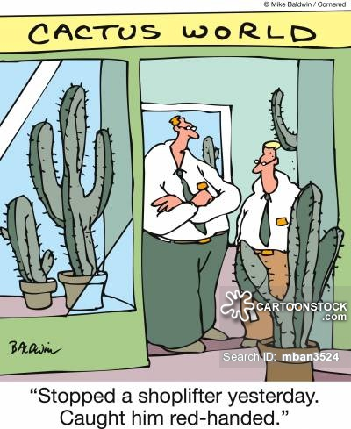
Shop Lifting-Theft
If you think someone is shoplifting;
Politely greet and make eye contact. Shoplifters hate attention, good customers do not.
Ask them if they require assistance.
If you are certain the person is shop lifting, DO NOT approach or try to stop them.
Never lock the door to stop a shoplifter from leaving. A trapped person is more likely to panic and become violent.

Slide 36

DO NOT chase the shoplifter. It will only invite violence. The item being stolen is not worth your life.
Immediately report the incident to security, manager or police.
WAIT until shoplifter leaves then write down as much information as possible including;
♦Height♦ Weight ♦Hair & Skin Colour ♦ Race ♦Clothing ♦ Vehicle Information if available.

Slide 37

Microsoft Online
What can you do with Microsoft Online:
How to Access
How do I ….?
How to Operate.
How to Check Email.
What company documents are available?
Tricks and Suggestions for Efficiency.
Questions?

Slide 38
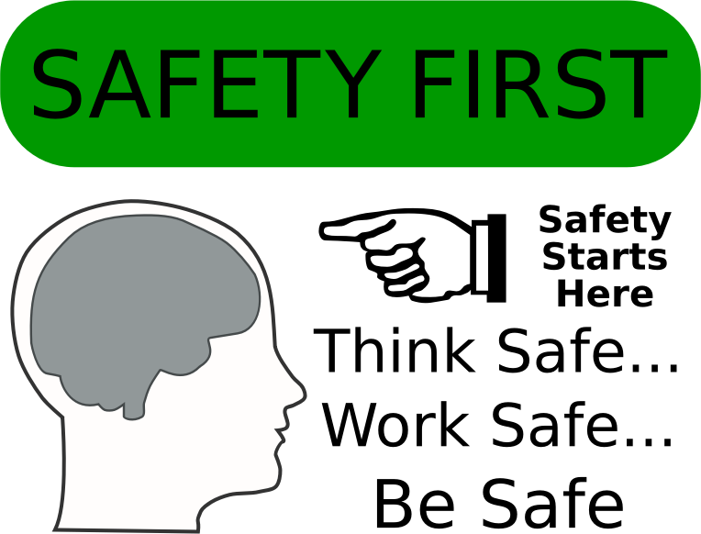
Thank You!

